Slide 1
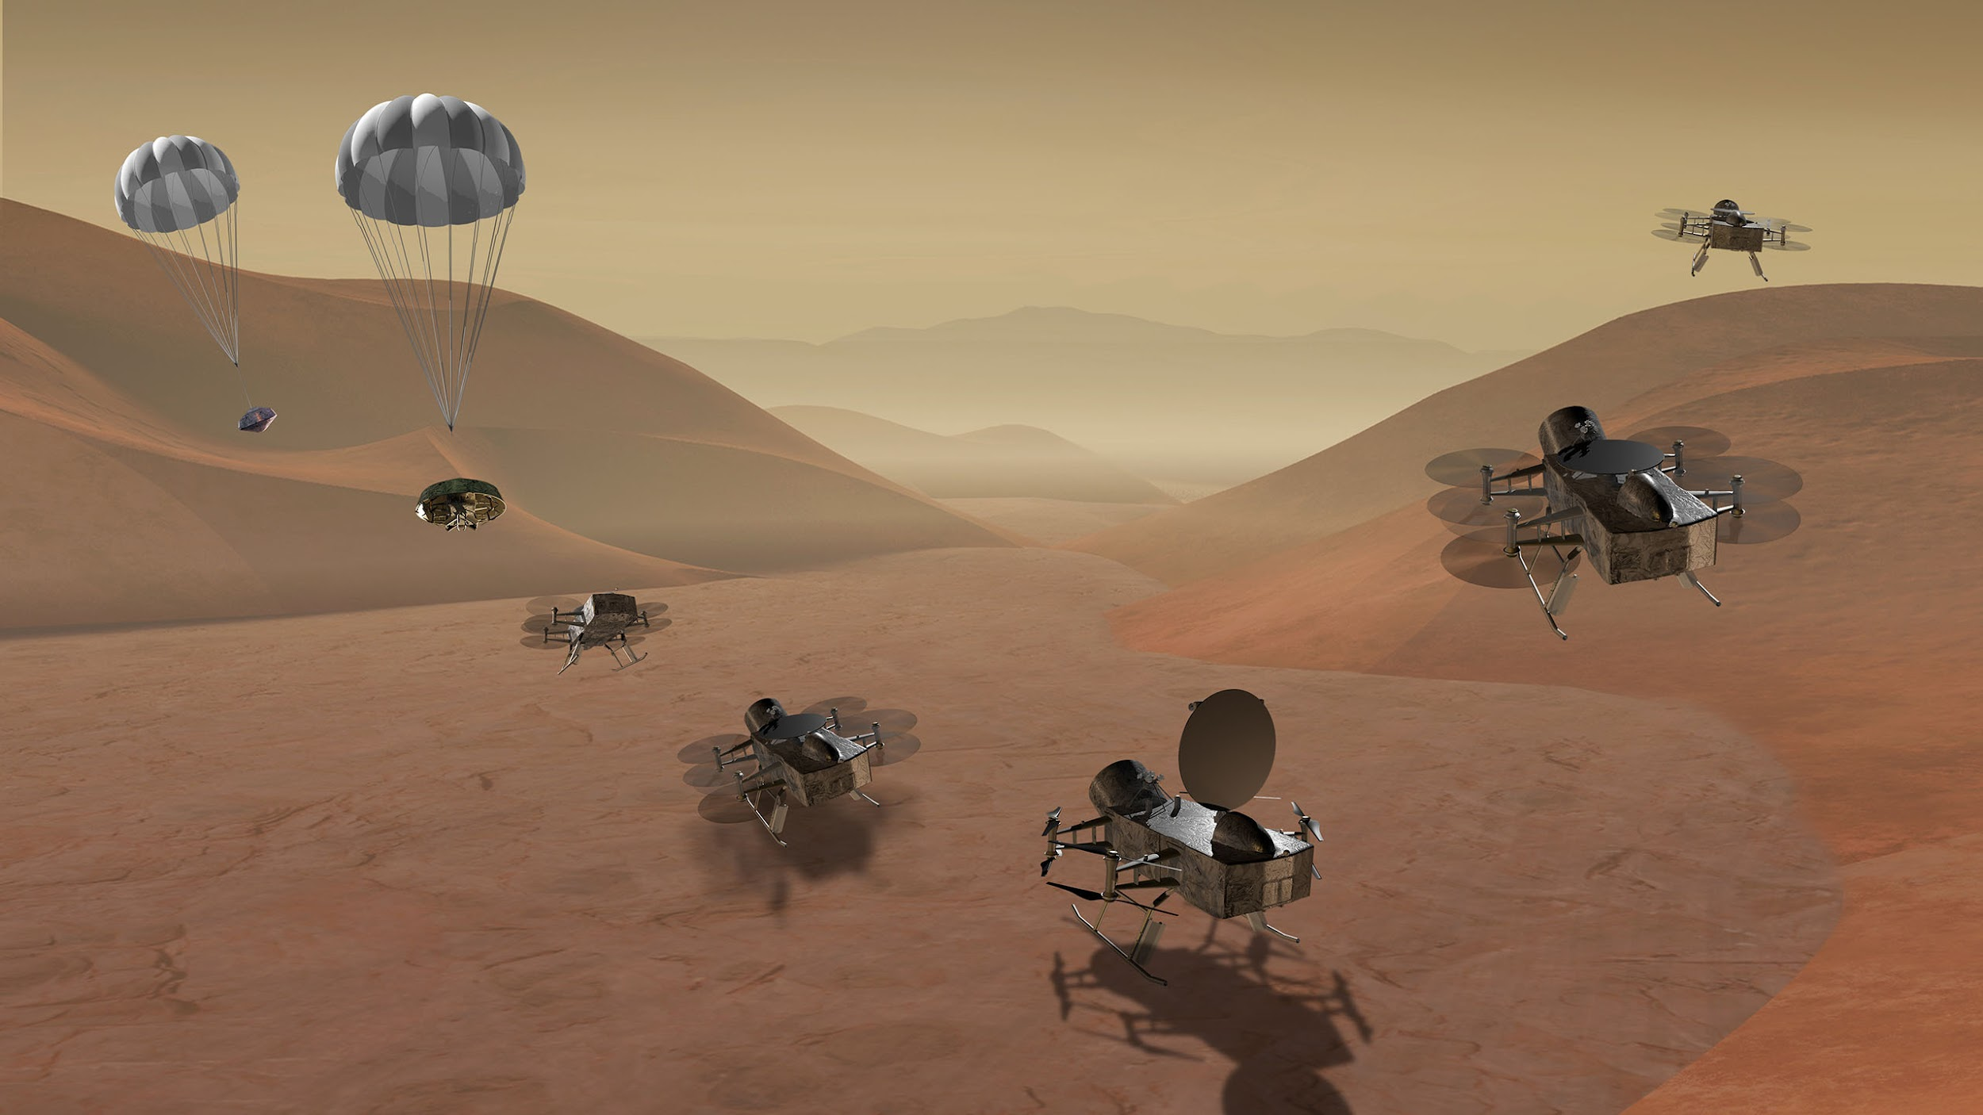
DraMS Diagram Viewer
DraMS Ops Training
robert.g.barbour@nasa.gov
eric.i.lyness@nasa.gov

Slide 2
Important Definitions
Mnemonics: A named data channel or field
Example: A temperature sensor or a boolean state
Model: A separate system with independent data
Example: Engineering model or flight model
Events: A text label with for an instance in time.
Example: 01-17-2025 12:32:21 “Started the pump”
Diagrams: A Diagram is an SVG image with an accompanying set of rules about how it should change in response to data. Those rules are divided into Switches and Indicators
Switches: A Switch is an on/off logical value. These can be defined as Event Switches, which turn on or off by matching text in Events, Mnemonic Switches, which turn on when a mnemonic is within a specific range, or Logical Switches, which allow you to combine multiple other switches
Indicators: An Indicator associates Switches with visual effects and particular elements in the Diagram image. Indicators can change colors, update text, or apply highlighting

Slide 3
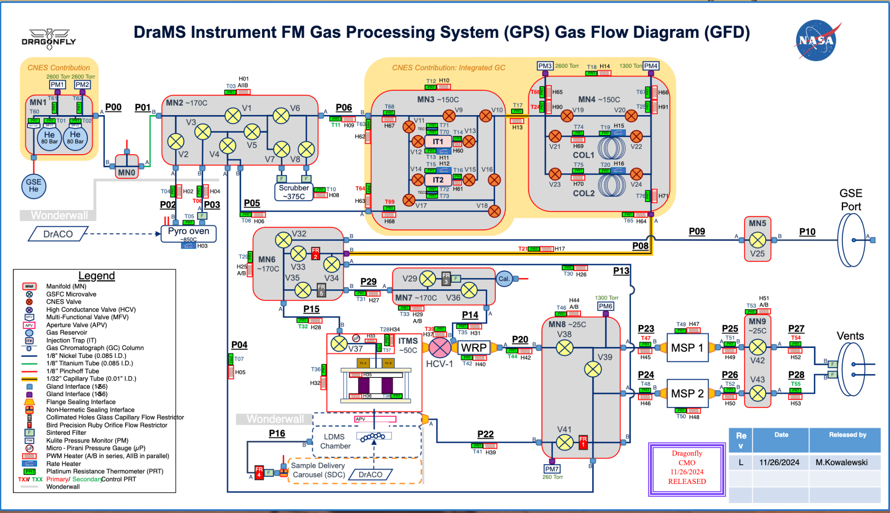
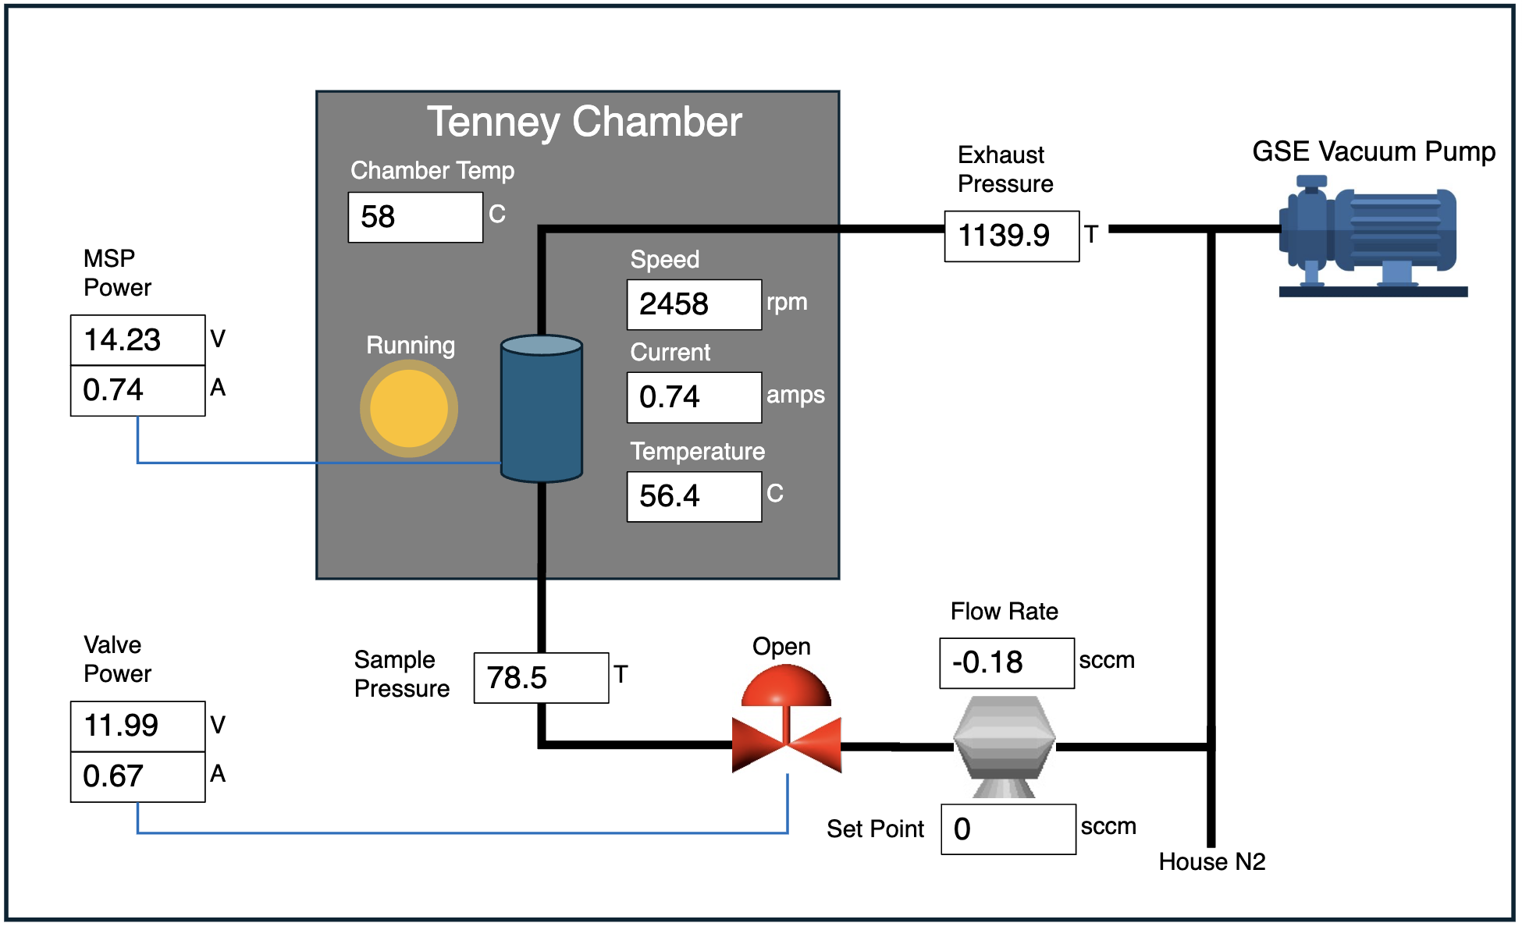
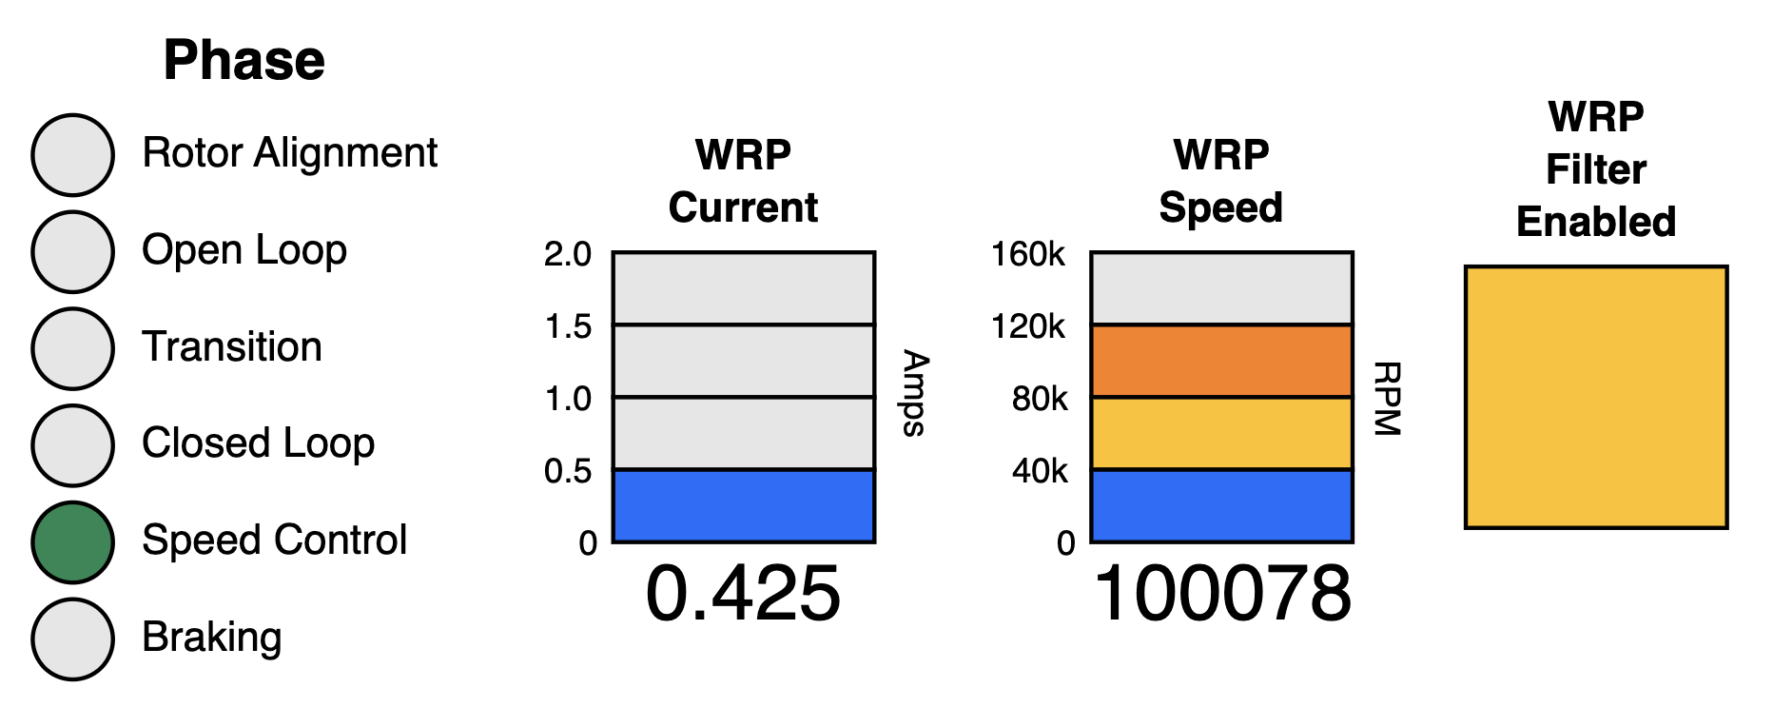
DraMS Diagram Viewer
The Diagram Viewer tool brings diagrams and schematics alive by changing diagram attributes, such as color or text, based on telemetry data.

Slide 4
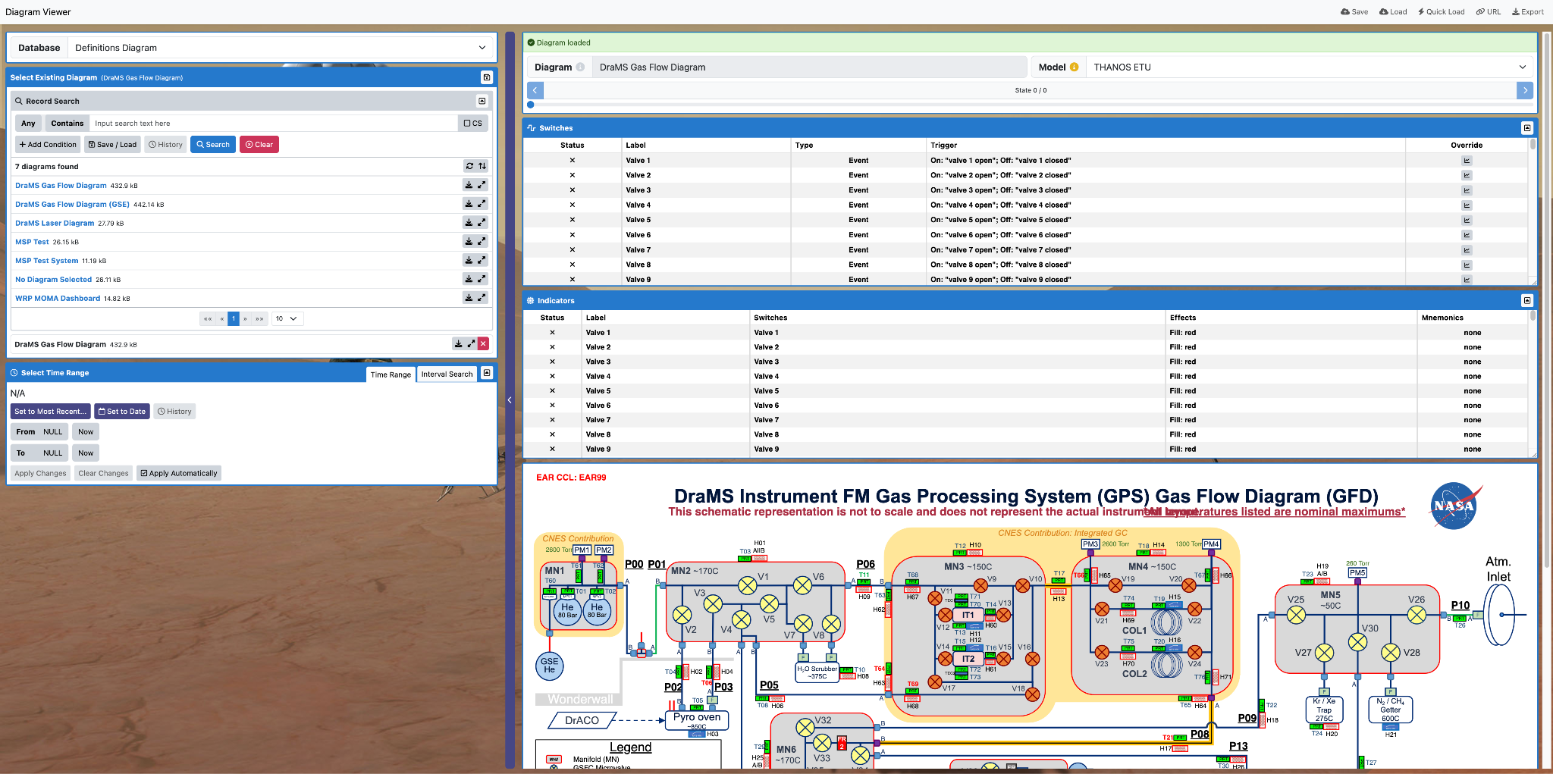
DraMS Diagram Viewer Overview
Database Selector
Diagram Summary
Diagram Selector
Switch Information
Indicator Information
Time Range/Interval Selector
Diagram
Click here to View Displayed Configuration in XINA

Slide 5
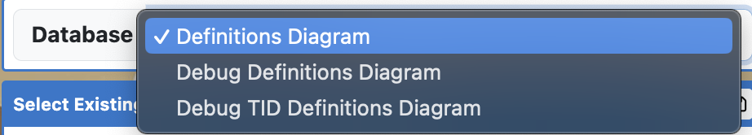
Selecting a Diagram (Database Selection)
Database Selector: Select which database to view diagrams from here.

Slide 6
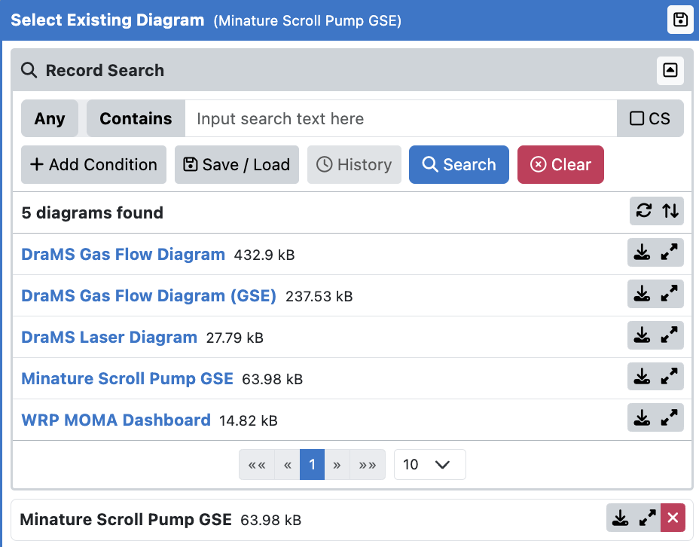
Selecting a Diagram (Diagram Listing/Selection)
Diagram List Collapser: Clicking this will open/collapse the list of existing diagrams. Note: the diagram list will automatically collapse after selecting a diagram, click this to reopen the diagram list.
Existing Diagrams List: The existing diagrams for the selected database are listed here.
Selected Diagram: The selected diagram is listed here.

Slide 7
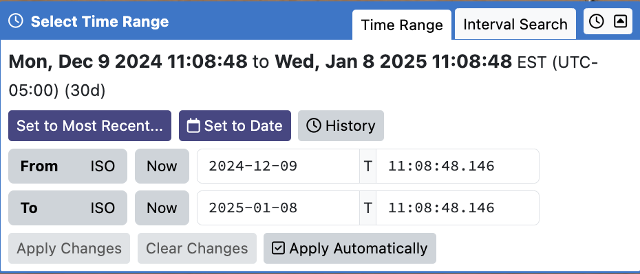
Time Range Selection
Time Range: Select time period for the data you want to view. There are a multitude of ways to accomplish this. From absolute dates, to most recent data, to data from test names.

Slide 8
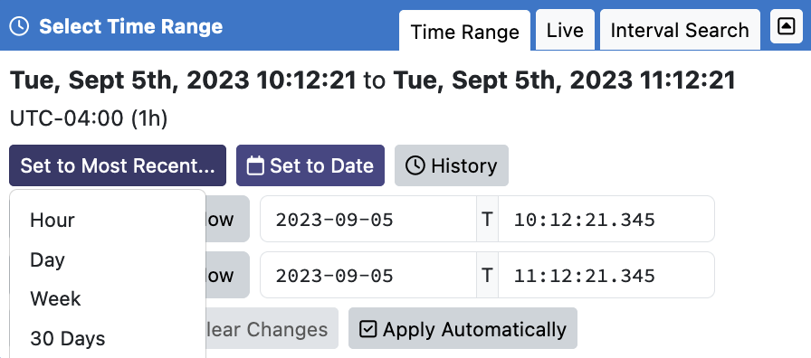
Time Range Selection
Set to Most Recent…: Allows you to quickly find the latest hour, day, week, or month of data for the selected model.

Slide 9
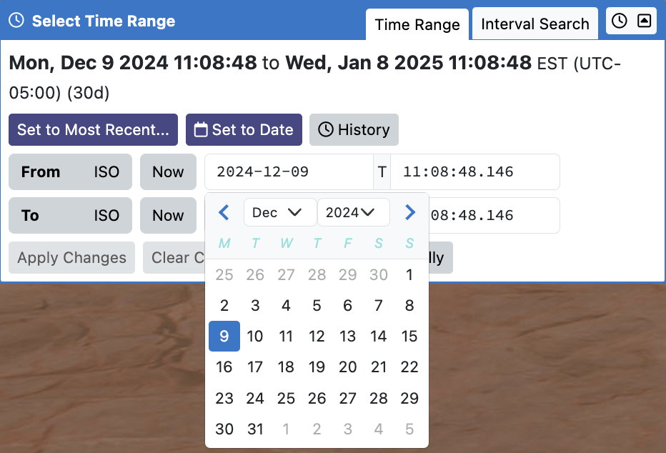
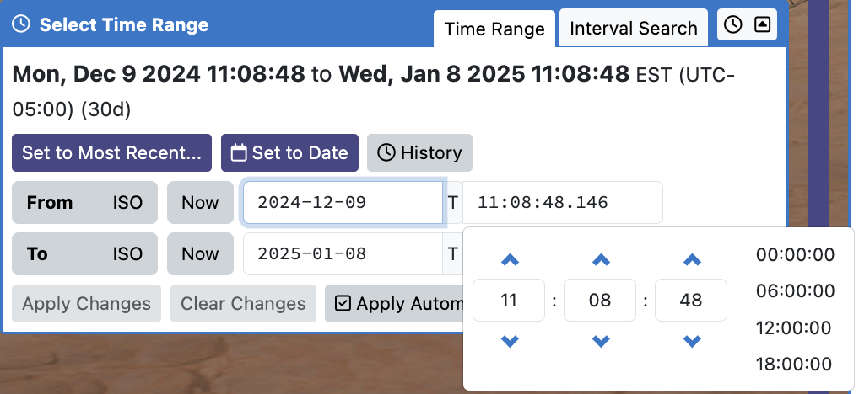
Time Range Selection
Setting the Date: Calendars will pop up when setting the start and end dates.
Setting the Time: A 24 hour clock will pop up when setting the start and end times.

Slide 10
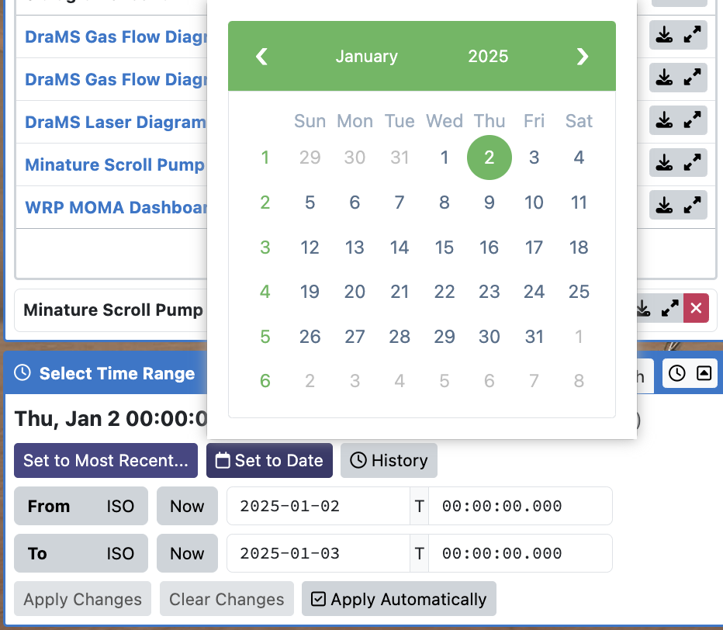
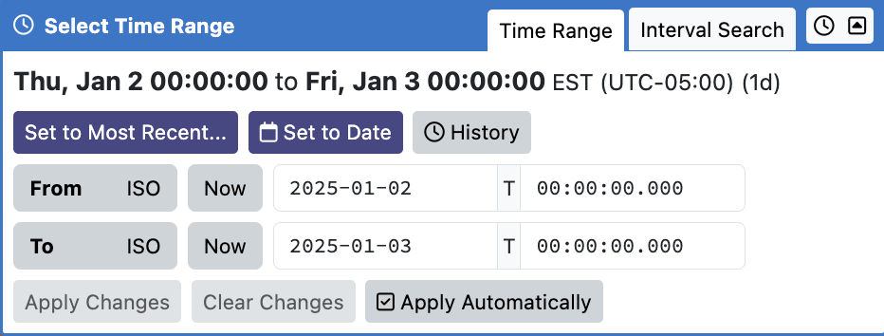
Time Range Selection
Clicking the “Set to Date” button will pull up a calendar.
Selecting a date will set the start and end times to contain the 24 hours of the chosen date.

Slide 11
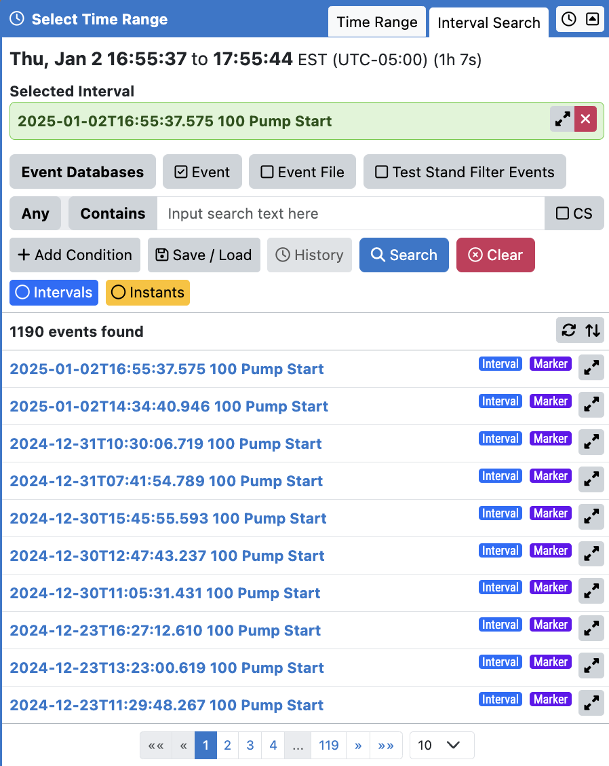
Time Range Selection (Interval)
Interval Search: An interval represents an event with a time range. If you are looking at a model that has saved intervals, you can select one and use its start/end time.
Selected Interval: The interval you selected will be displayed here. You can go to the “Time Range” tab, see the new start/end time, and adjust them if need be.
Available Events: List of available intervals saved as named events.
The event file naming convention is:
(Date)T(Time) (Event ID) (Event Name)
The software that runs the tests automatically records key events.

Slide 12
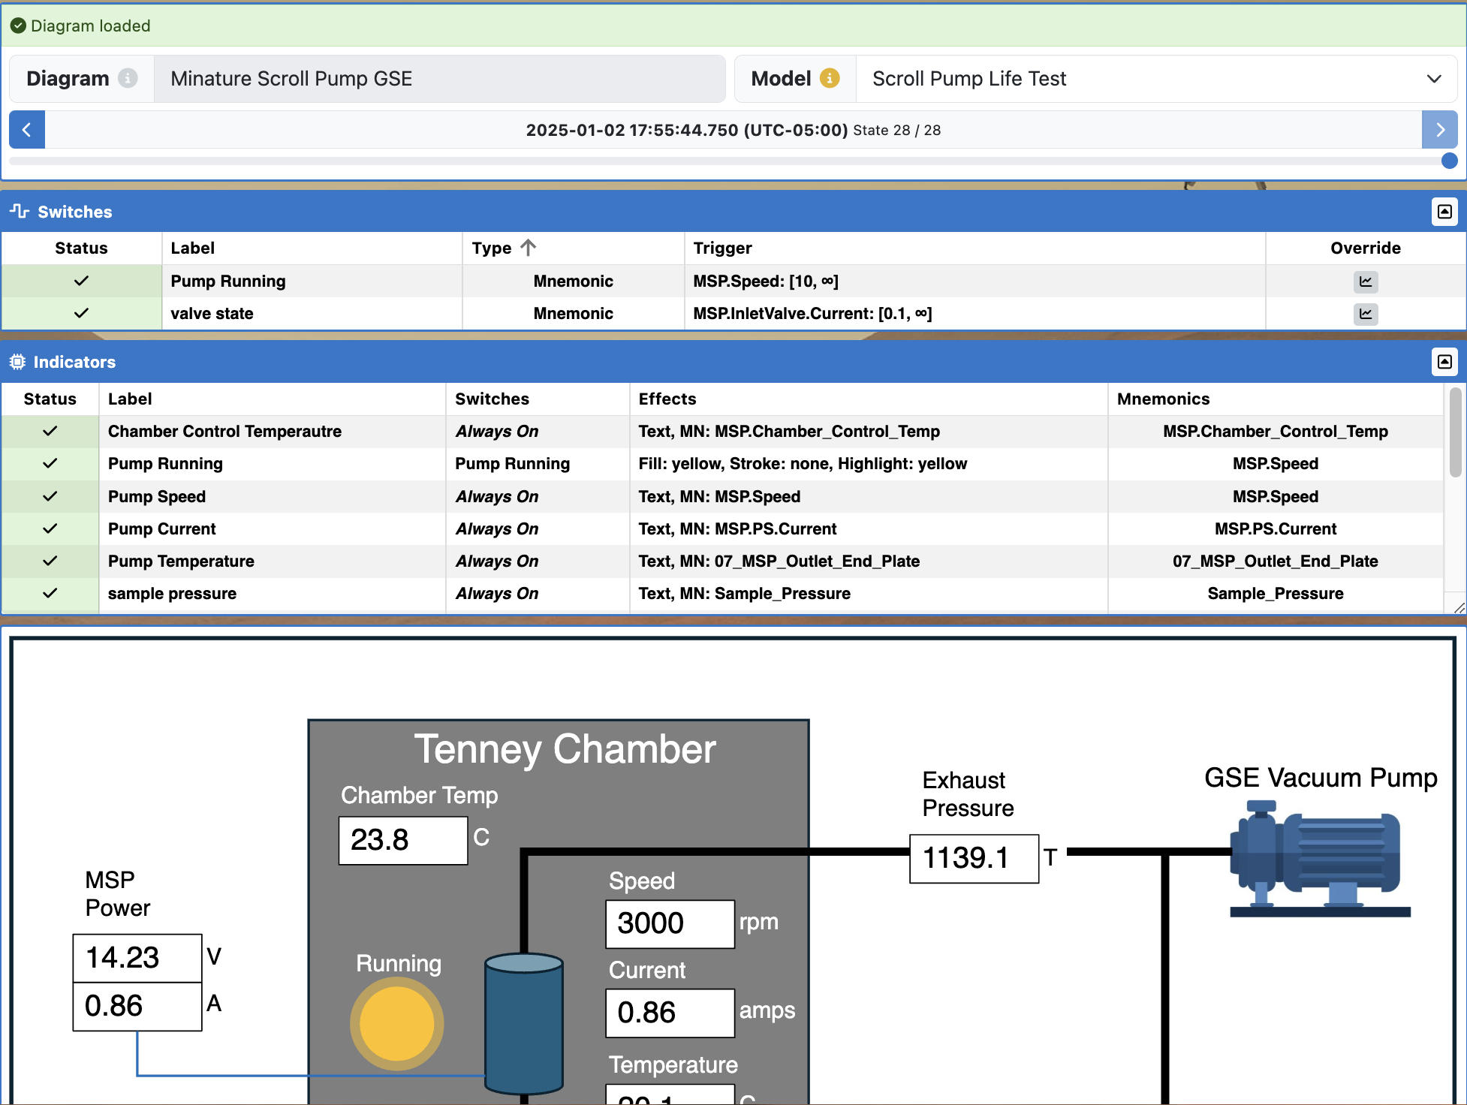
Viewing the Selected Diagram
The Diagram Summary provides some basic information and controls.
Displays all switches for the current Diagram, including their current status and override controls.
Displays all indicators for the current Diagram, including their current status.
Displays the Diagram here. Scroll to zoom and click/drag to pan. If the diagram has interactable elements, they can be clicked.
Click here to View Displayed Configuration in XINA

Slide 13
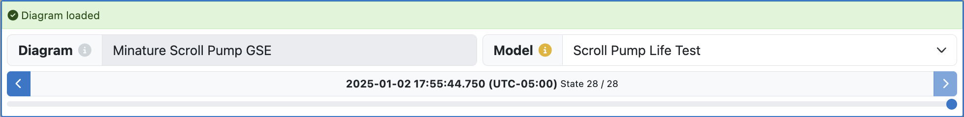
Diagram Summary
The selected Diagram’s name, which is used for all exported files.
Select the hardware model here. The model determines the data source and mnemonic definitions.
Select an instant within the loaded data. Can be used to step forward and backward through data states. This changes the data displayed in the switches and indicators.

Slide 14
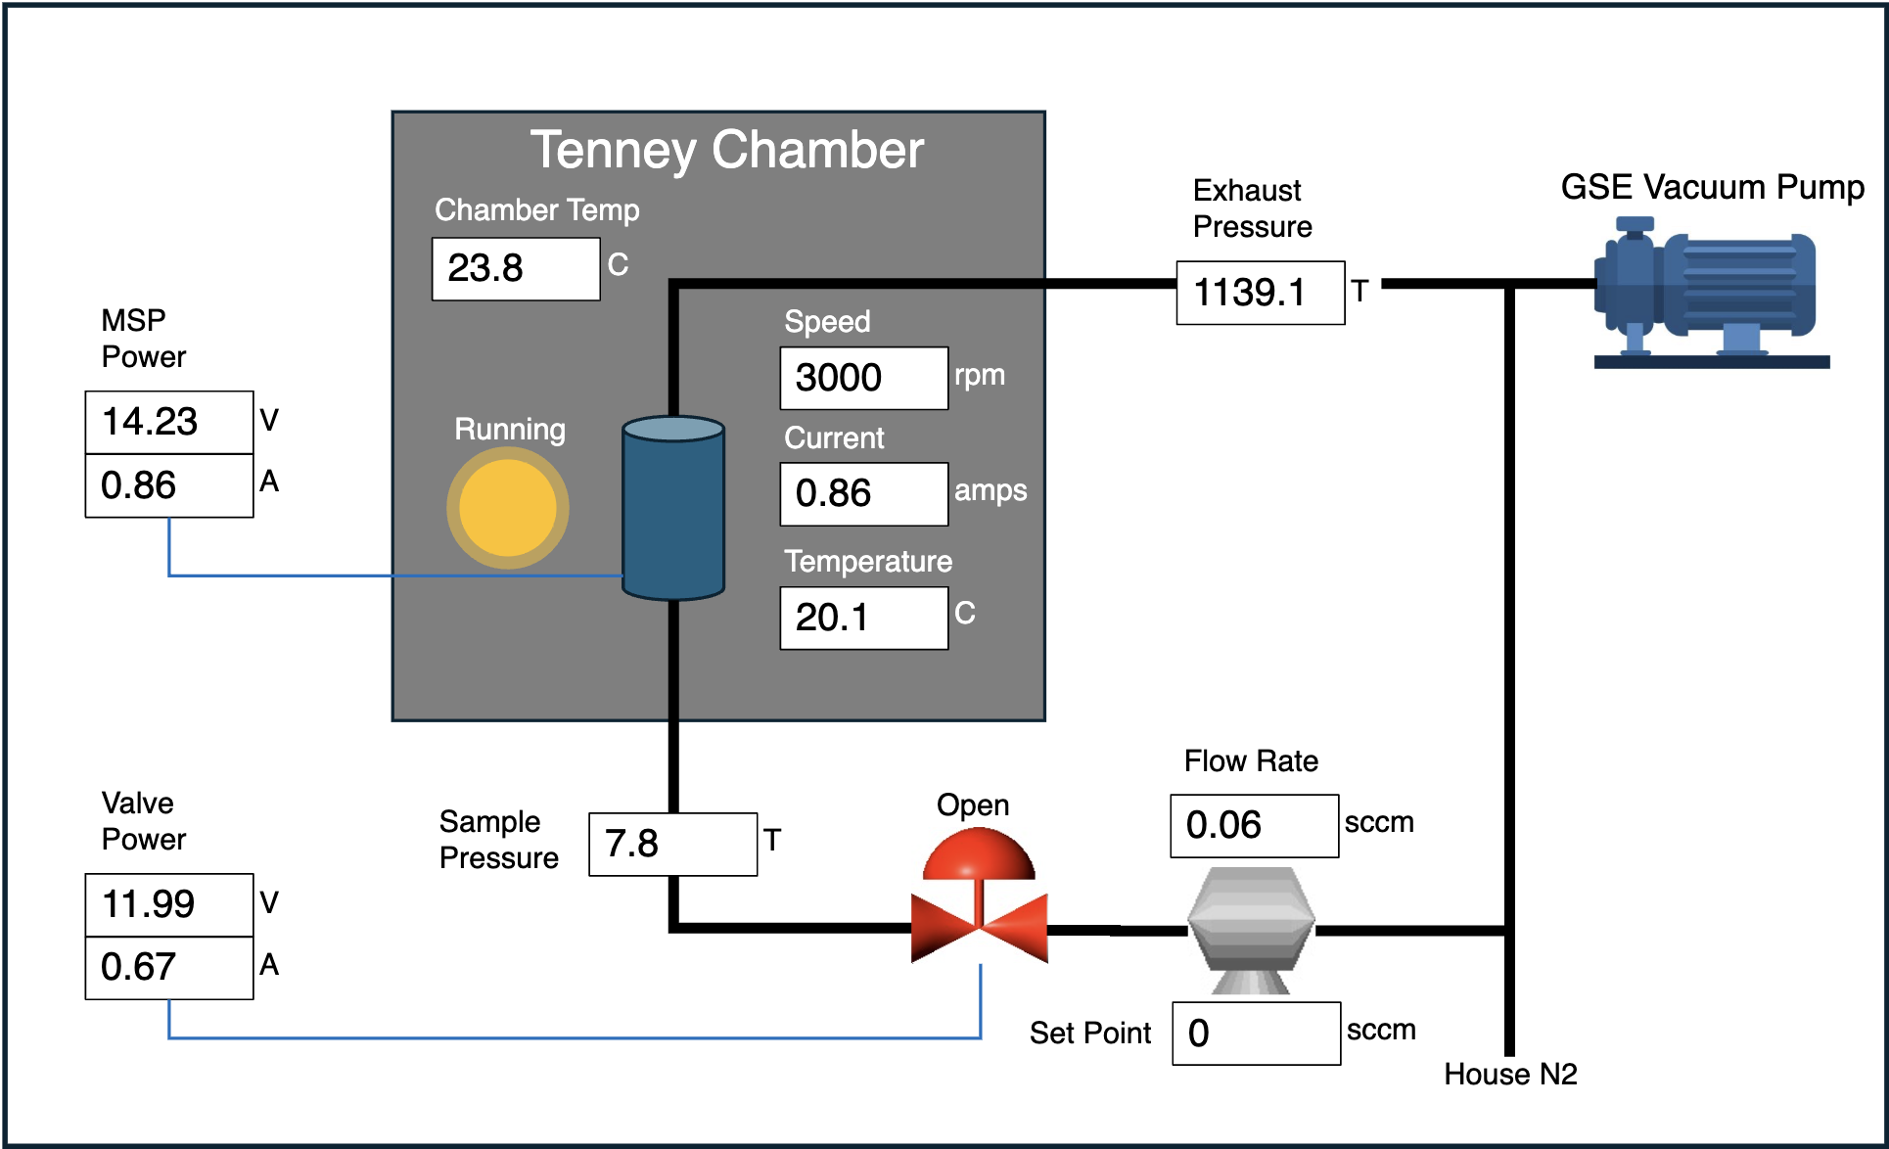
Viewing the Data
You can view the values of each indicator in the current data state on the diagram. These values will update as you step through the available states on the diagram summary.
Click here to View Displayed Configuration in XINA

Slide 15
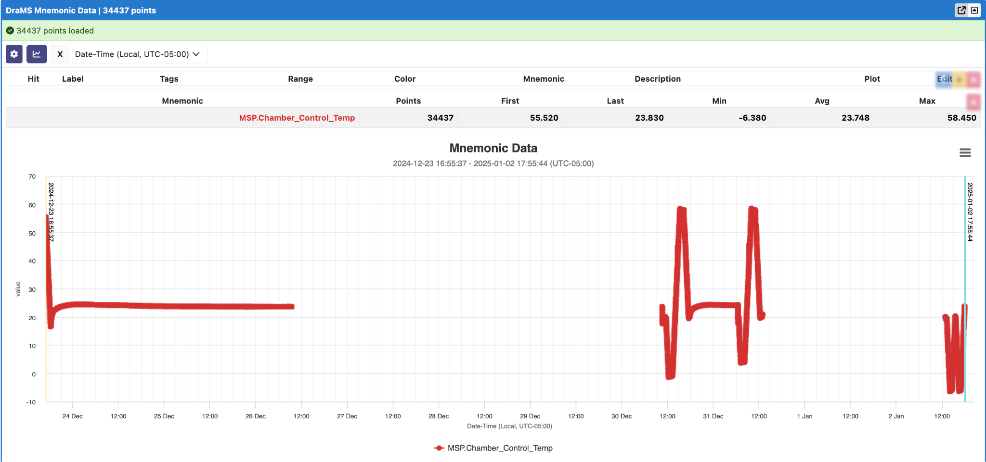
Viewing the Data
Clicking on an indicator on the diagram will open a window containing the mnemonic data plotted across the selected time range.
Click here to View Displayed Configuration in XINA

Slide 16
Sharing, Saving, and Loading Configurations
It is possible to share and save the current state of the tool, as well as load a previously saved configuration. Please click here to view the sharing, saving, and loading tutorial.

