Slide 1
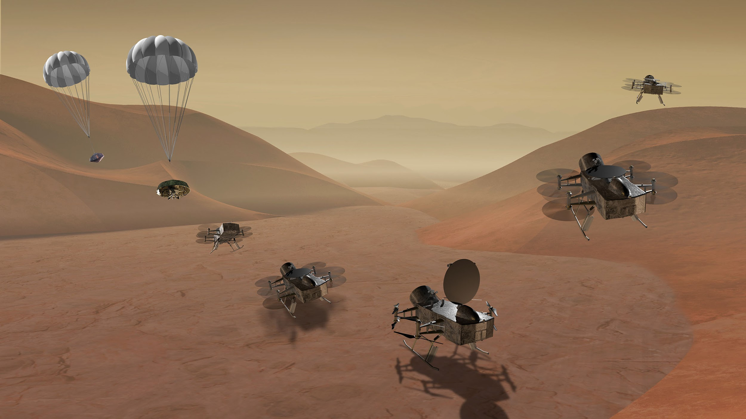
DraMS Diagram Simulator
DraMS Ops Training
robert.g.barbour@nasa.gov
eric.i.lyness@nasa.gov

Slide 2
Important Definitions
Mnemonics: A named data channel or field Example: A temperature sensor or a boolean state
Model: A separate system with independent data Example: Engineering model or flight model
Events: A text label with for an instance in time. Example: 01-17-2025 12:32:21 “Started the pump”
Diagrams: A Diagram is an SVG image with an accompanying set of rules about how it should change in response to data. Those rules are divided into Switches and Indicators
Switches: A Switch is an on/off logical value. These can be defined as Event Switches, which turn on or off by matching text in Events, Mnemonic Switches, which turn on when a mnemonic is within a specific range, or Logical Switches, which allow you to combine multiple other switches
Indicators: An Indicator associates Switches with visual effects and particular elements in the Diagram image. Indicators can change colors, update text, or apply highlighting
Sequence Files: Simple text (.txt) files containing simulated data streams, one step per line

Slide 3
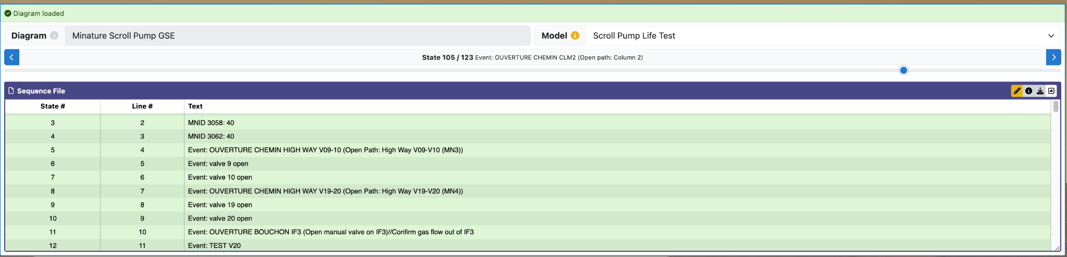
DraMS Diagram Editor
The Diagram Simulator tool allows you to view responsive diagrams and dashboards with simulated data in the form of sequence files. For real data, use the Diagram Viewer.

Slide 4
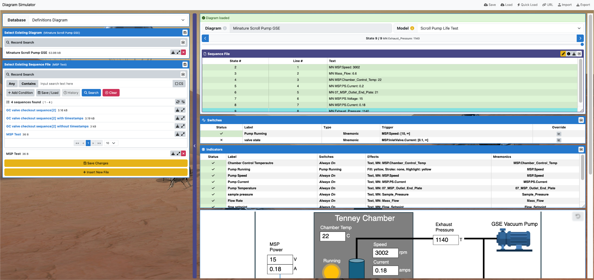
DraMS Diagram Simulator Overview
Database Selector
Diagram Summary
Diagram Selector
Sequence File
Sequence File Selector
Switch Information
Indicator Information
Diagram

Slide 5
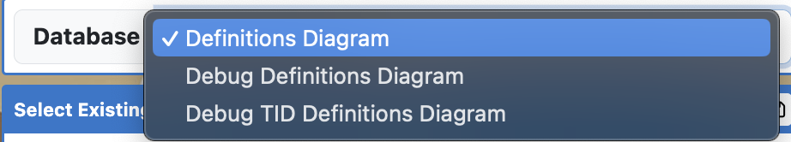
Selecting a Diagram (Database Selection)
Database Selector: Select which database to view diagrams from here.

Slide 6
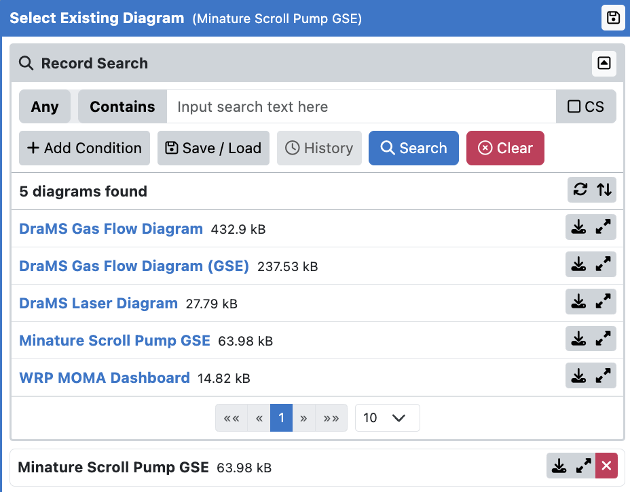
Selecting a Diagram (Diagram Listing/Selection)
Diagram List Collapser: Clicking this will open/collapse the list of existing diagrams. Note: the diagram list will automatically collapse after selecting a diagram, click this to reopen the diagram list.
Existing Diagrams List: The existing diagrams for the selected database are listed here.
Selected Diagram: The selected diagram is listed here.

Slide 7
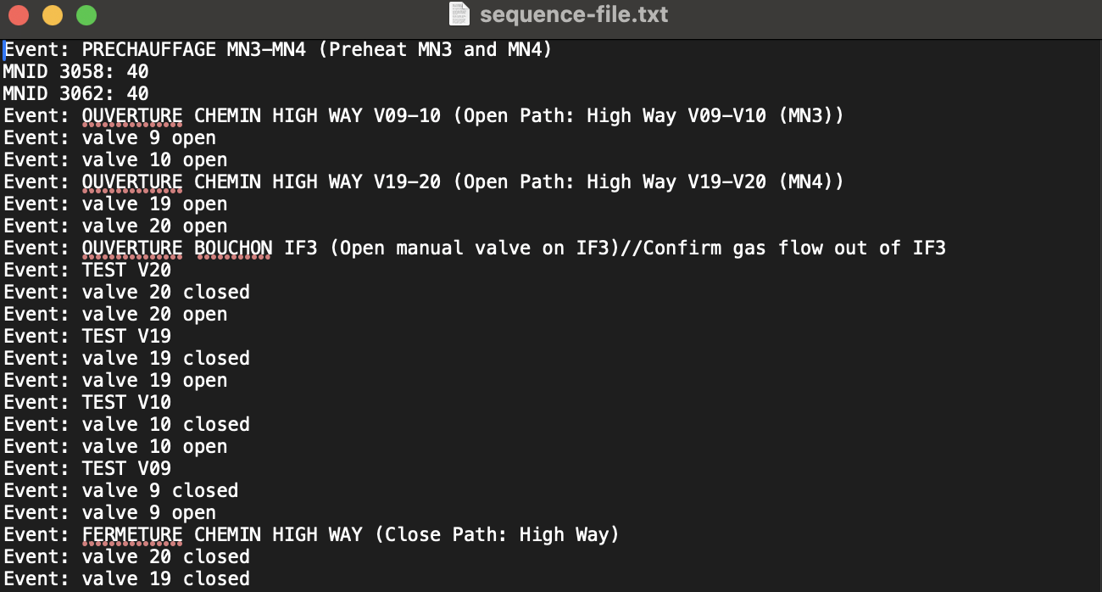
Sequence Files
Sequence files are text files that contain simulated data streams, one step per line. As you step through the lines of the sequence file; the diagram, switches, and indicators will reflect the simulated data.

Slide 8
Sequence File Format
The format for sequence files is fairly straightforward:
For Event data, Event: <event text>, e.g. Event: valve 1 open
For Mnemonic data, MNID <mnid>: <value>, e.g. MNID 10: 125.3
Alternatively, you can use the Mnemonic name, MN <mn name>: <value>, e.g. MN mrp.heater_current: 125.3
For timestamps, T <timestamp><units>, e.g. T 125ms. Units default to seconds or can be any of w/d/h/m/s/ms/us. A + before the timestamp will be interpreted as an offset relative to the previous, e.g. T +10.2h
For comments, the line should start with // or #

Slide 9
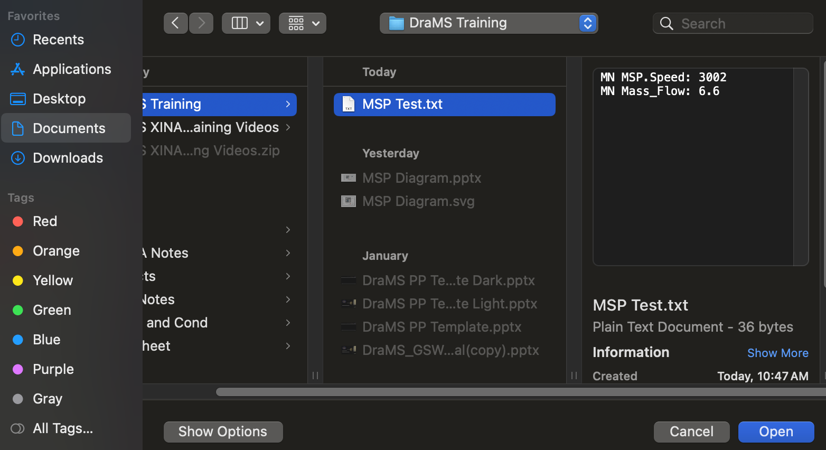
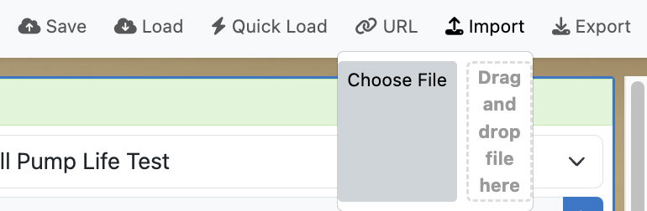
Importing Sequence Files
Then, you can either click “Choose File,” file the sequence text file, and click “Open.” Or you can drag the sequence file from your file system onto the window labeled “Drag and drop file here.”
To upload a sequence file, simply click on the “import” button in the top-right.

Slide 10
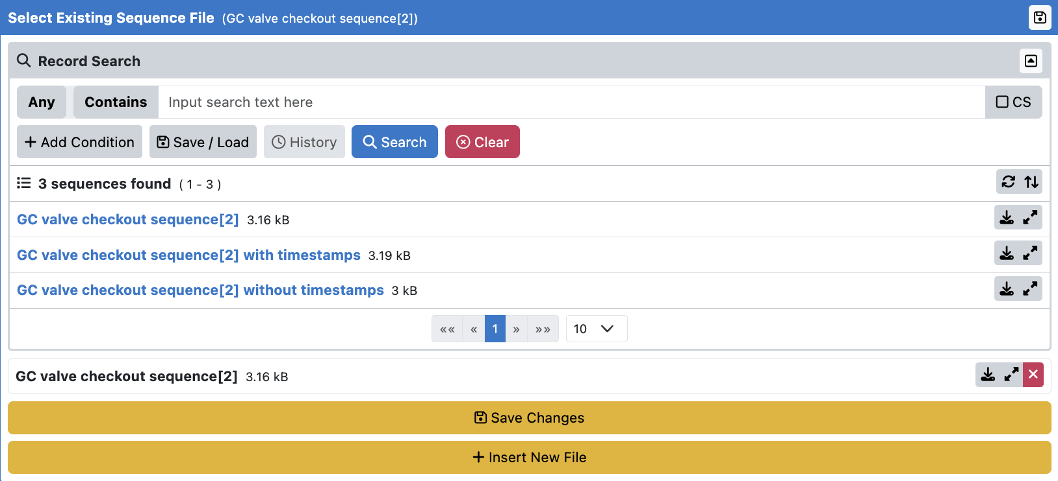
Sequence Files Listing/Selection
Existing Sequence Files List: The existing sequence files for the selected database are listed here.
Selected Sequence Files: The selected sequence file is listed here.
Save Sequence File: You can save changes made to the currently selected sequence file here.
Insert New Sequence File: This button adds the currently loaded sequence file to the database.

Slide 11
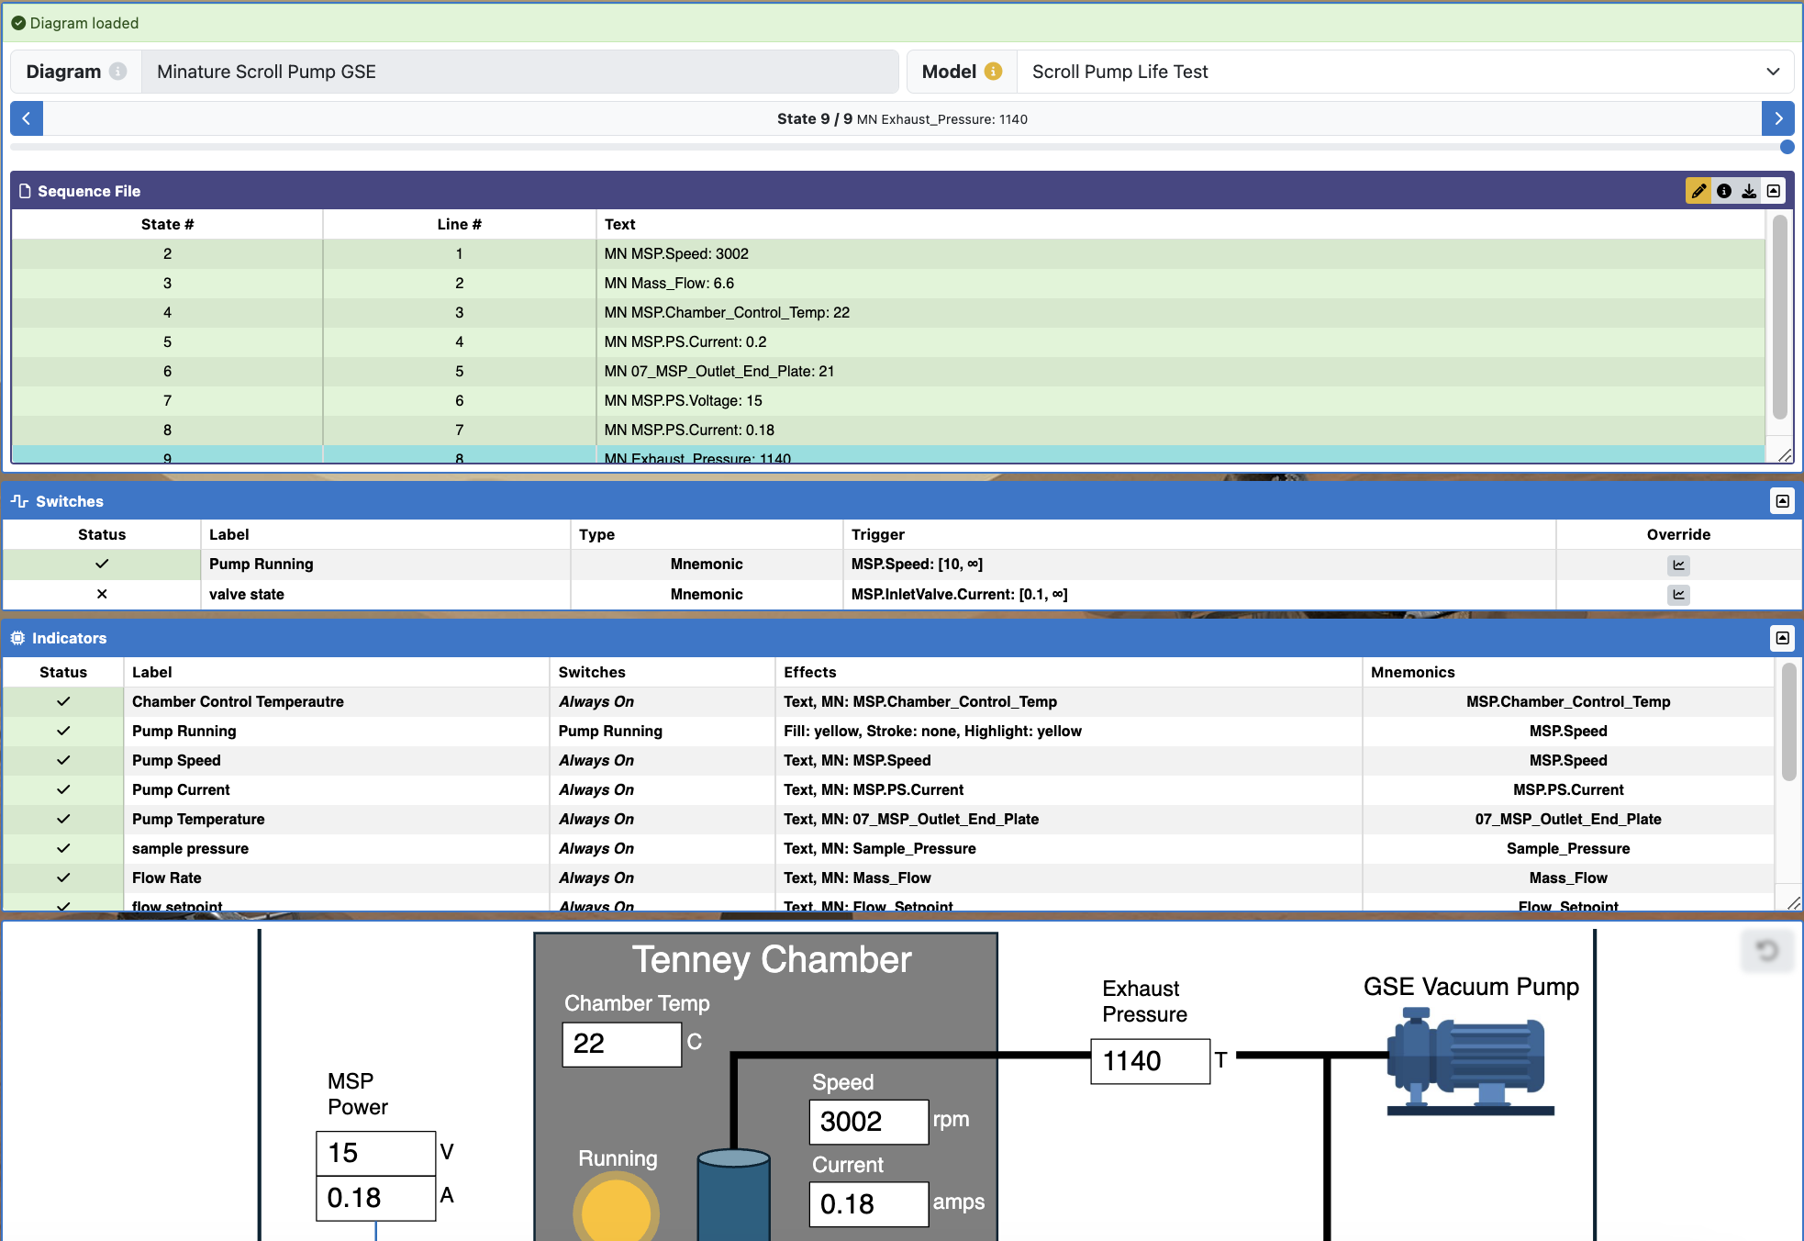
Viewing the Selected Diagram
The Diagram Summary provides some basic information and controls.
Displays all switches for the current Diagram, including their current status and override controls.
Displays all indicators for the current Diagram, including their current status.
Displays the Diagram here. Scroll to zoom and click/drag to pan. If the diagram has interactable elements, they can be clicked.

Slide 12
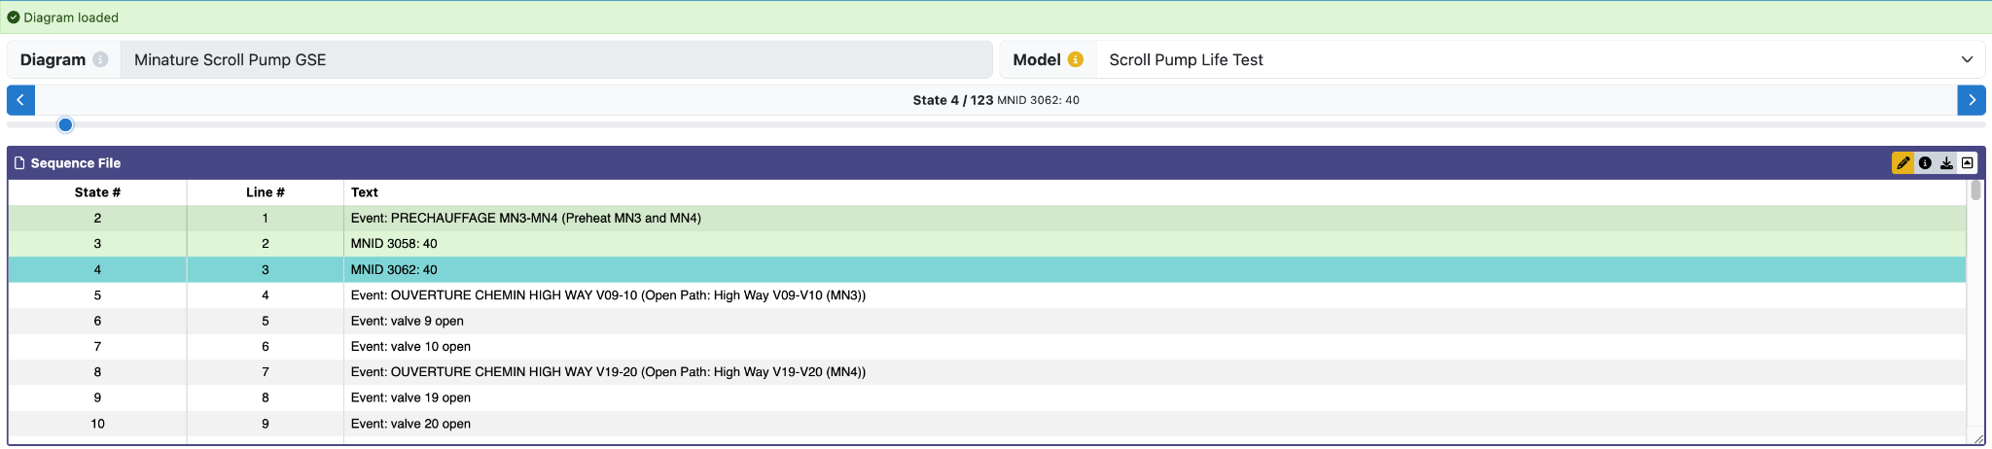
Diagram Summary
The selected Diagram’s name, which is used for all exported files.
Selected state within the sequence file. Can be stepped forward/backward. This changes the data displayed in the switches and indicators.
Select the hardware model here. The model determines the data source and mnemonic definitions.
Selected sequence file. Here, the sequence file can be edited or downloaded. Current state can be seen here.

Slide 13
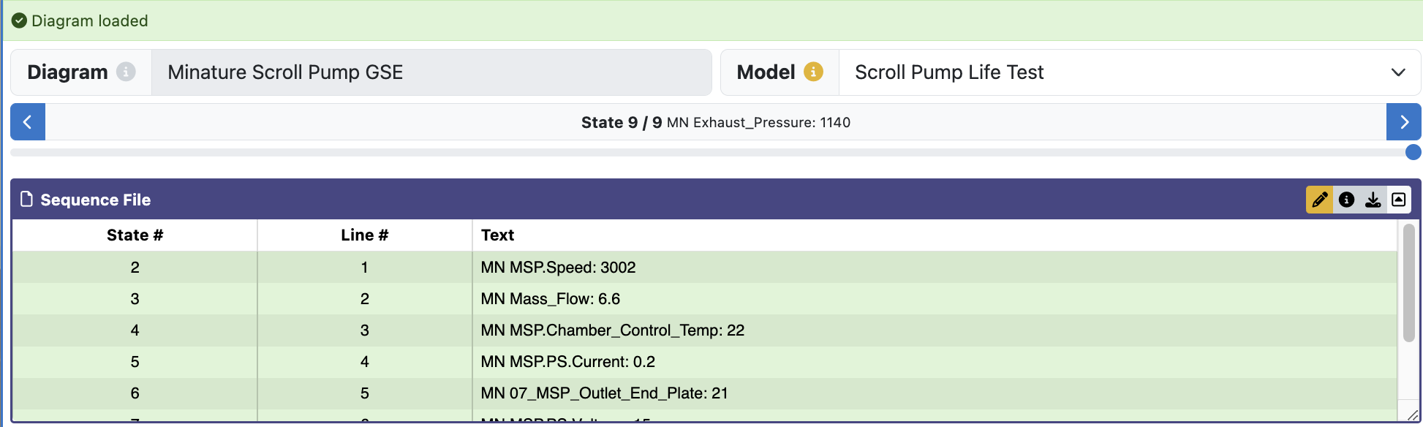
Diagram Summary
Click the “pencil” icon to edit the sequence file directly on XINA. This is useful for quick adjustments in simulated data.
Click this button to download the selected sequence file to your computer.

Slide 14
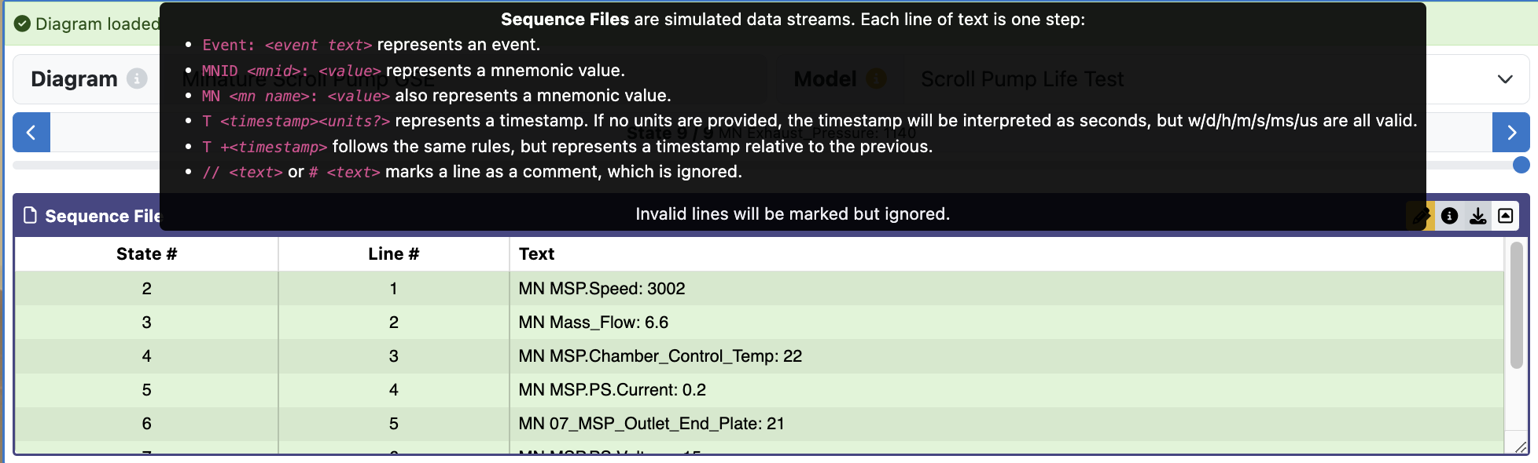
Diagram Summary
If you ever forget the syntax of the sequence files and want to make any edits, click the info button here. A pop up containing the sequence file syntax will appear.

Slide 15
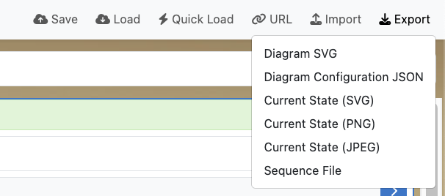
Exporting Files
To export any of the files from XINA, click the “export” button in the top-right and select the file that you wish to download.

Slide 16
Sharing, Saving, and Loading Configurations
It is possible to share and save the current state of the tool, as well as load a previously saved configuration. Please click here to view the sharing, saving, and loading tutorial.

