Slide 1
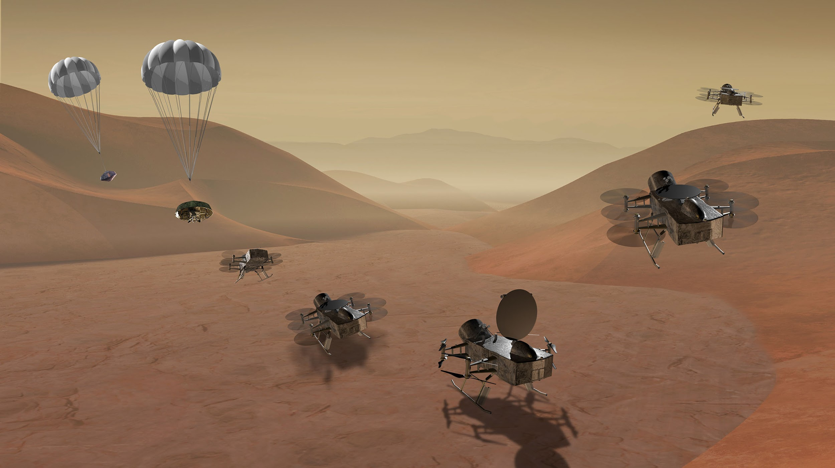
DraMS Diagram Editor
DraMS Ops Training
robert.g.barbour@nasa.gov
eric.i.lyness@nasa.gov

Slide 2
Important Definitions
Mnemonics: A named data channel or field Example: A temperature sensor or a boolean state
Model: A separate system with independent data Example: Engineering model or flight model
Events: A text label with for an instance in time. Example: 01-17-2025 12:32:21 “Started the pump”
Diagrams: A Diagram is an SVG image with an accompanying set of rules about how it should change in response to data. Those rules are divided into Switches and Indicators
Switches: A Switch is an on/off logical value. These can be defined as Event Switches, which turn on or off by matching text in Events, Mnemonic Switches, which turn on when a mnemonic is within a specific range, or Logical Switches, which allow you to combine multiple other switches
Indicators: An Indicator associates Switches with visual effects and particular elements in the Diagram image. Indicators can change colors, update text, or apply highlighting

Slide 3
DraMS Diagram Editor
The Diagram Editor tool allows you to create and manage responsive diagrams and dashboards. While you can view data here, the Diagram Viewer and Diagram Simulator are better suited for that purpose. The layout of the Diagram Editor is almost identical to the Diagram Viewer, so please refer to the Diagram Viewer tutorial for an introduction.

Slide 4
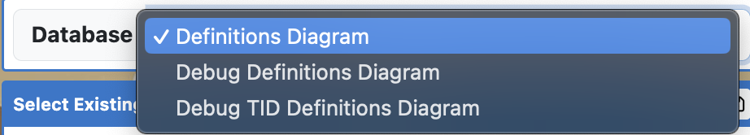
Selecting a Diagram (Database Selection)
Database Selector: Select which database to view diagrams from here.

Slide 5
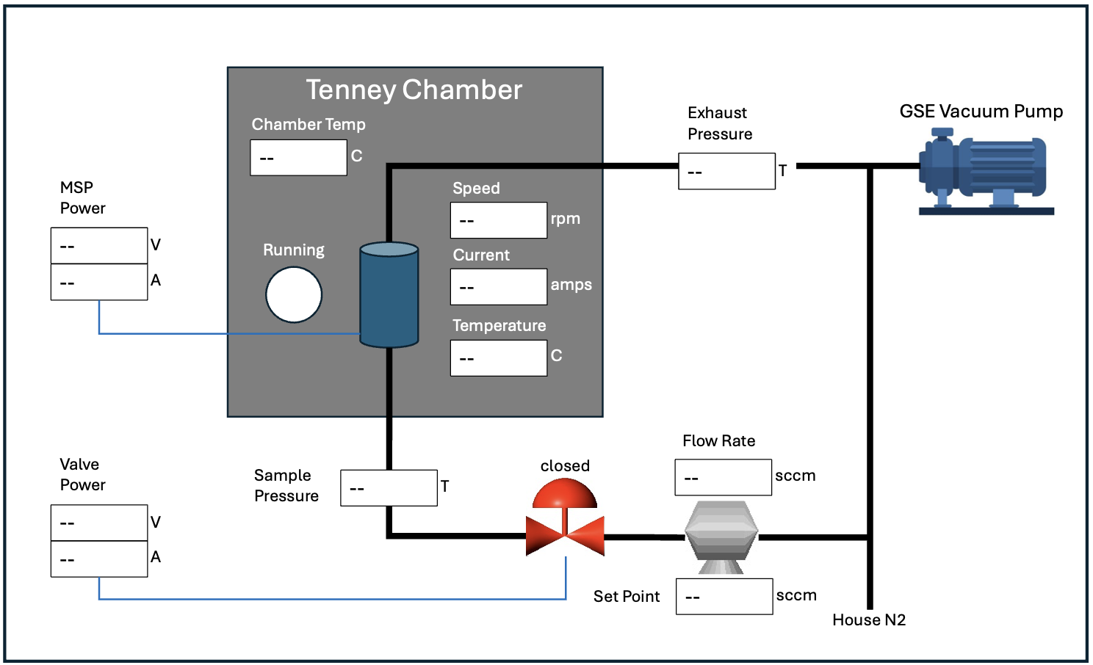
SVG Files in XINA
XINA can accept any .SVG file. An SVG files is a image file that consists of a list of objects and the attributes. XINA can modify the objects’ attributes.
Software such as Inkscape can be used to edit SVG files. Powerpoint slides can also be saved as SVG files.

Slide 6
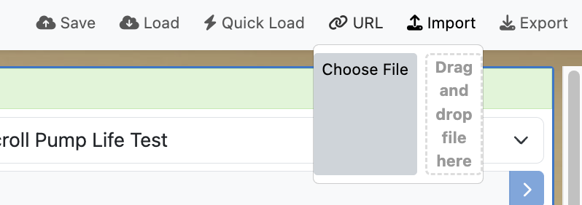
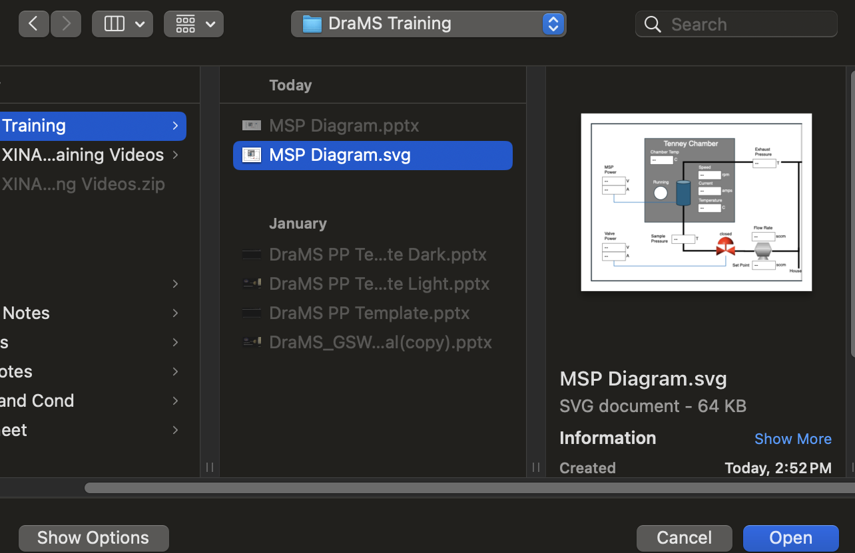
Uploading SVG Files to XINA
Then, you can either click “Choose File,” file the SVG file, and click “Open.” Or you can drag the SVG file from your file system onto the window labeled “Drag and drop file here.”
To upload an SVG file, simply click on the “import” button in the top-right.

Slide 7
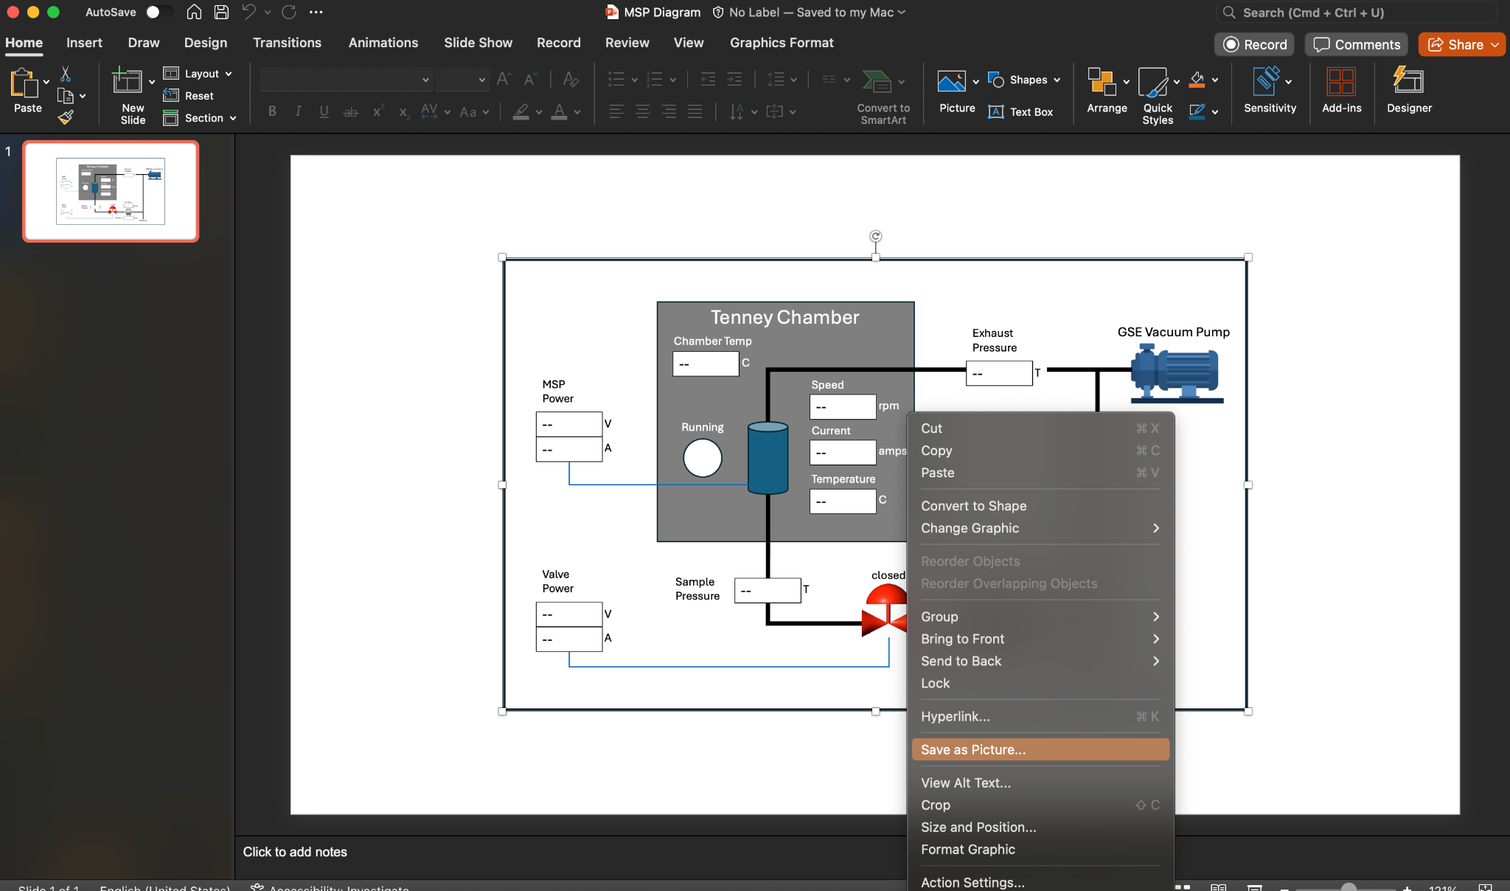
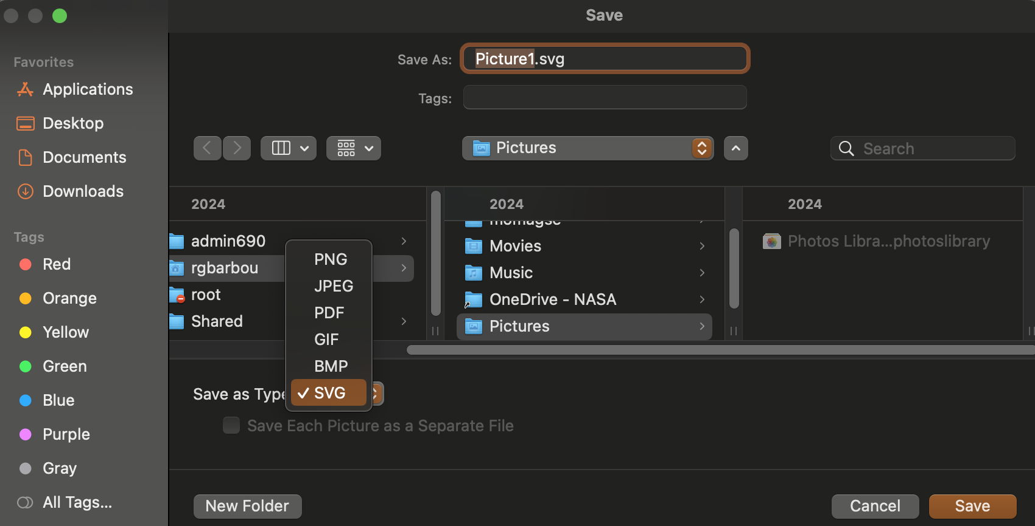
How to make an SVG in Powerpoint
The easiest way to create an SVG image is in Powerpoint.
Once your diagram on Powerpoint is finished, highlight the whole diagram, right click on it, then click on “Save as Picture.”
Open the dropdown menu next to “Save as Type” and select “SVG.”

Slide 8
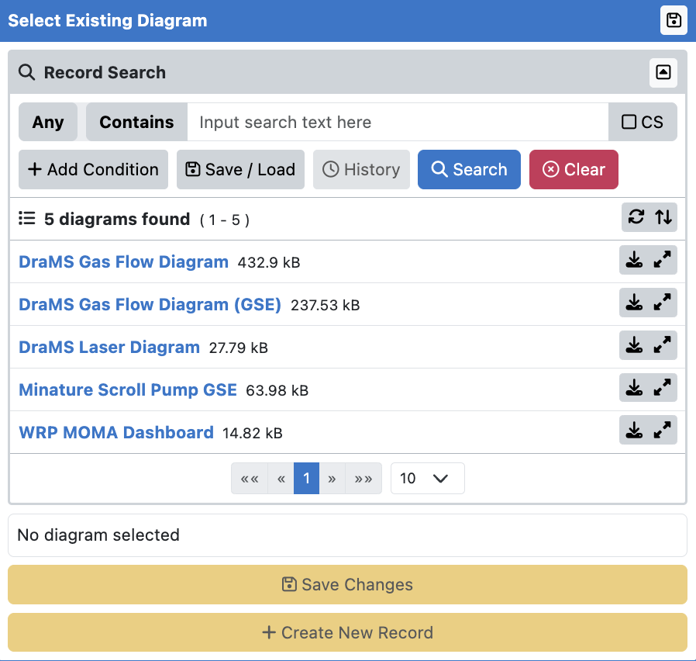
Creating/Updating Diagrams
List of existing diagrams.
Button to save changes made to the currently selected diagram.
Button to add the current diagram to the selected database.

Slide 9
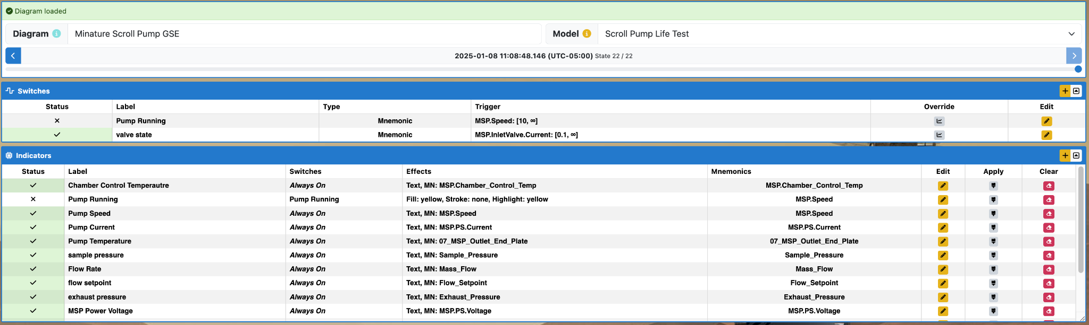
Creating Switches
Click the “+” icon here to open a window to configure a new switch. There are three types of switches.

Slide 10
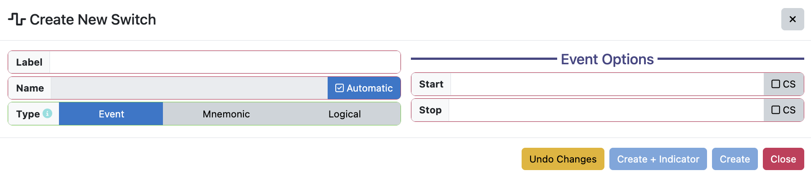
Switch Types (Event)
Event switches are turned on by an event matching the “Start” text, and turned off by an event matching the “Stop” text.
For instance, the text message “Pump Running” could be used to set a switch called “Pump On” = True, the text message “Pump Stopped” is used to make “Pump On” = False.

Slide 11
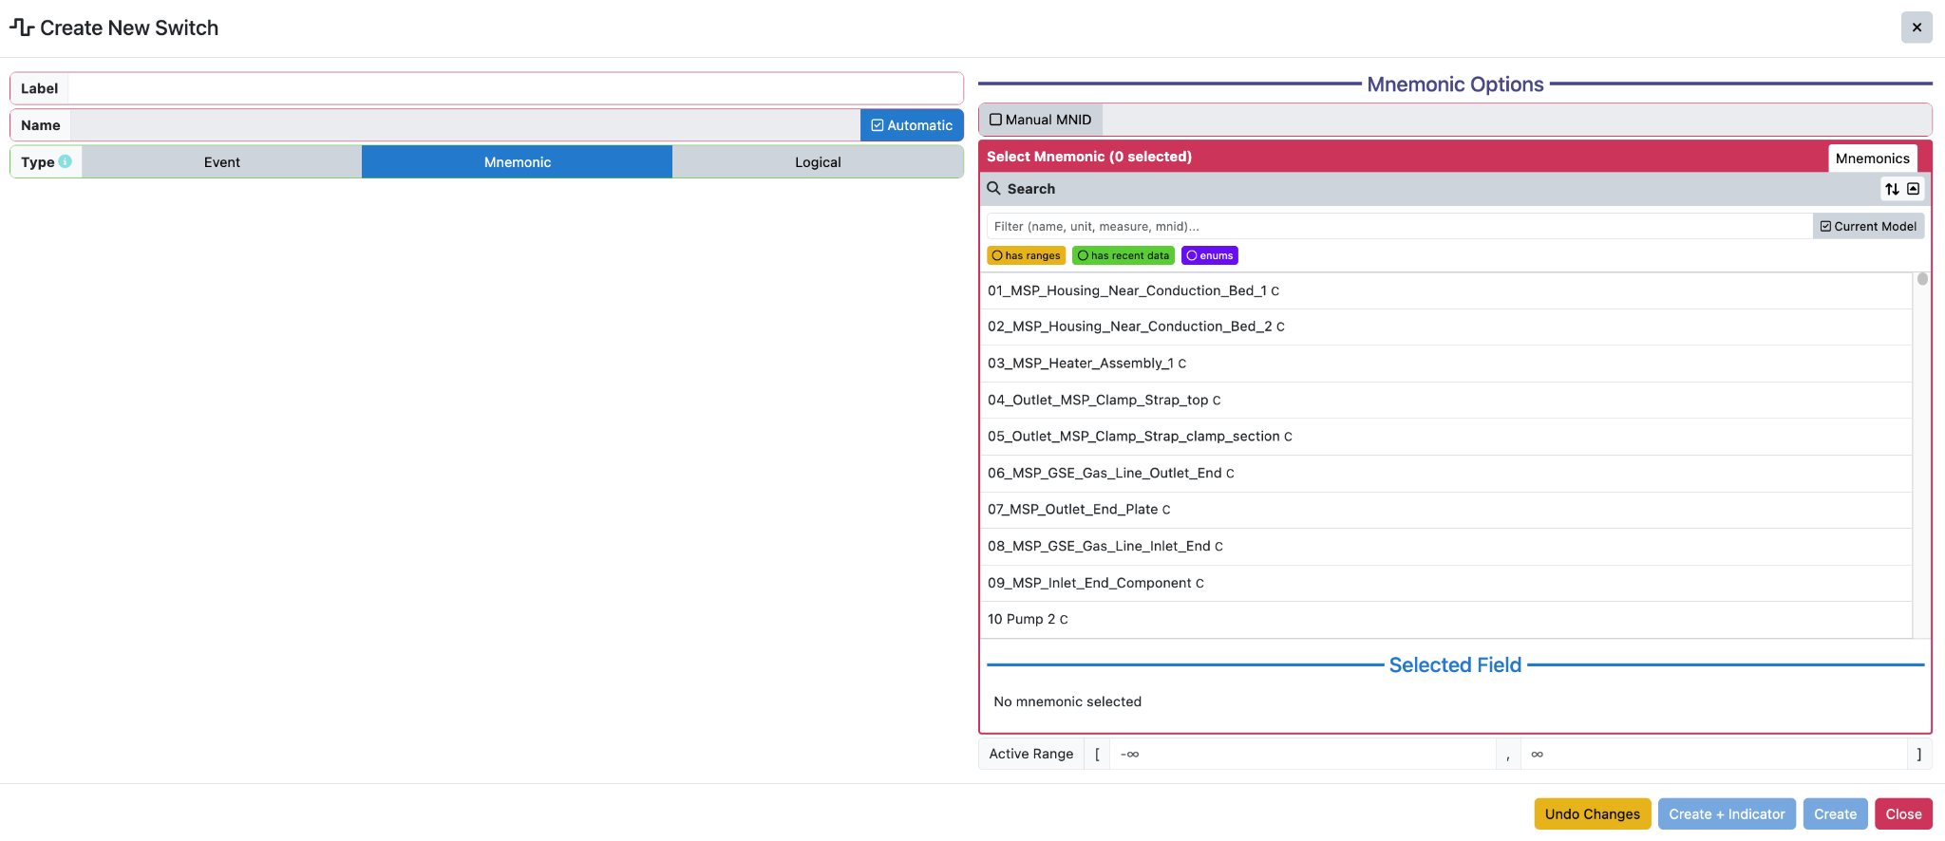
Switch Types (Mnemonic)
Mnemonic switches are active while the selected mnemonic value is within the specified range.
For instance, the switch called “Pump Running” is set to True when the “MSP.Speed” mnemonic has a value greater than 10.

Slide 12
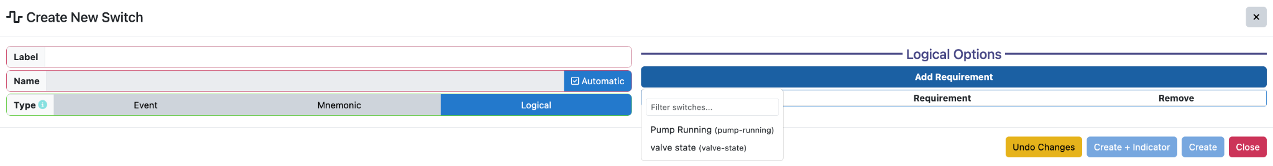
Switch Types (Mnemonic)
Logical switches are defined based on whether certain other switches are active.

Slide 13
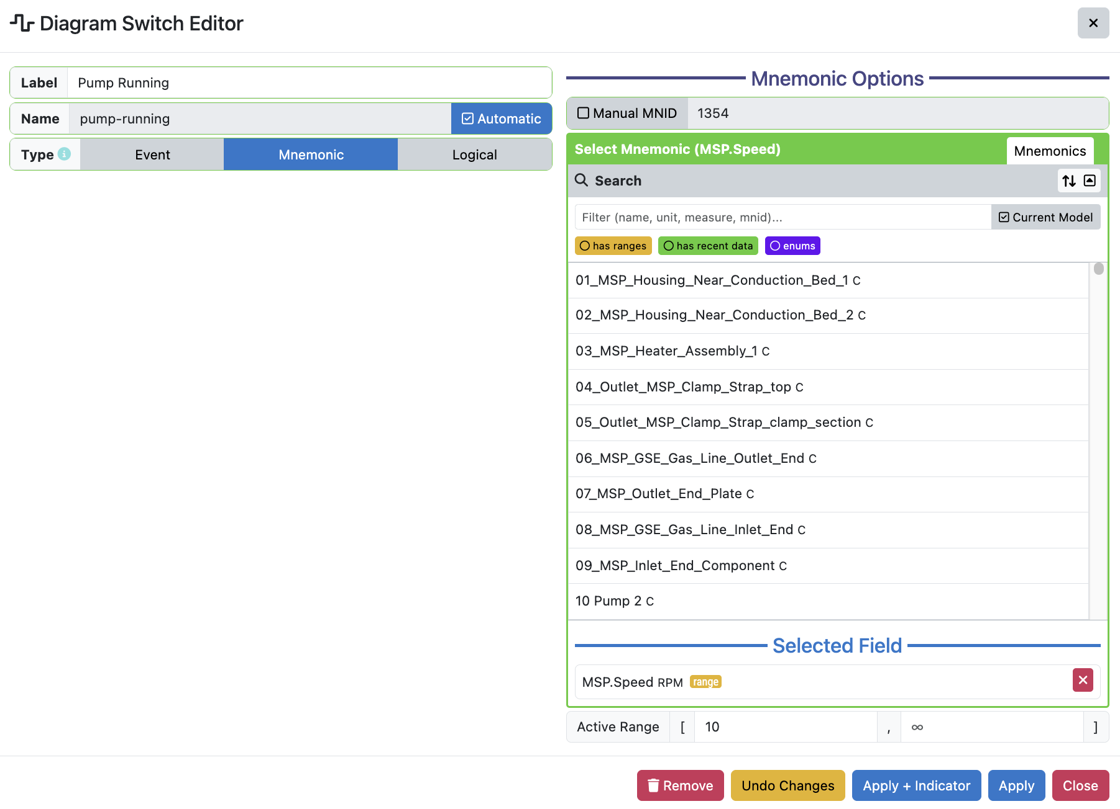
Updating Switches
Click the “pencil” icon next to an existing switch to open the switch editor.

Slide 14
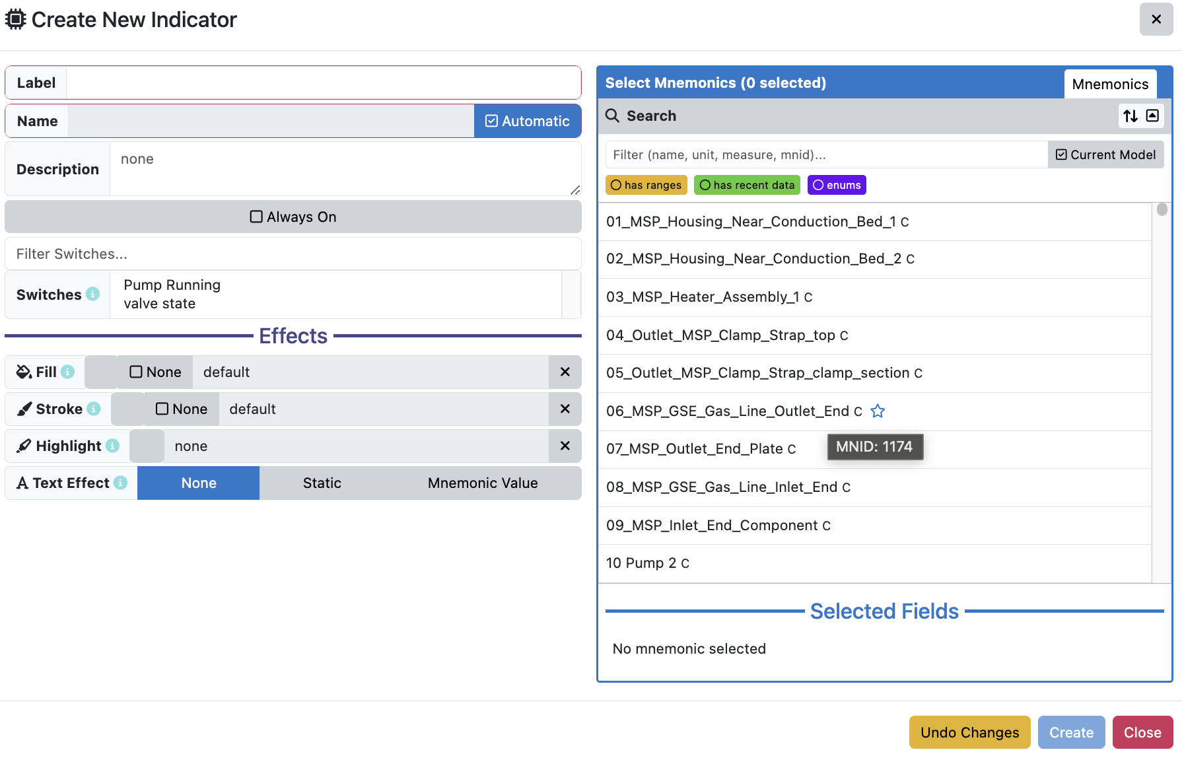
Creating Indicators
Indicators are SVG objects that change based on Switches or mnemonics.
Click the “+” icon here to open a window to configure a new indicator.

Slide 15
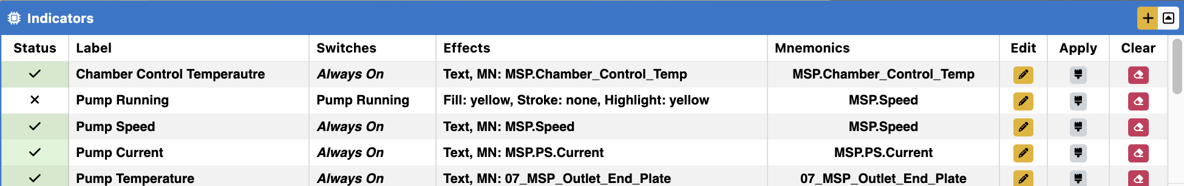
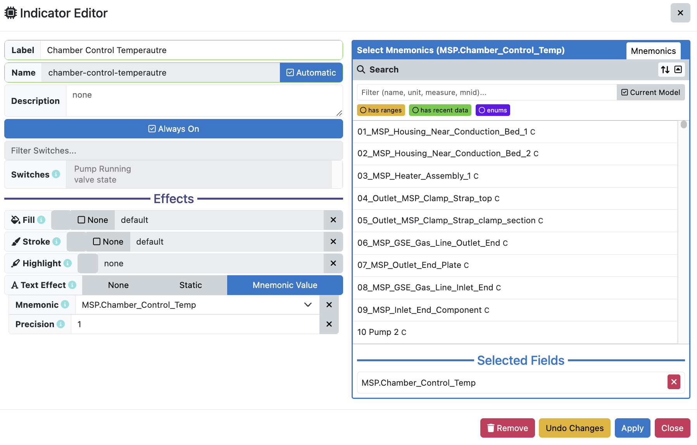
Updating Indicators
Click the “pencil” icon next to an existing indicator to open the indicator editor. Here, the indicator can be fully reconfigured. Once you are satisfied, click “Apply.”

Slide 16
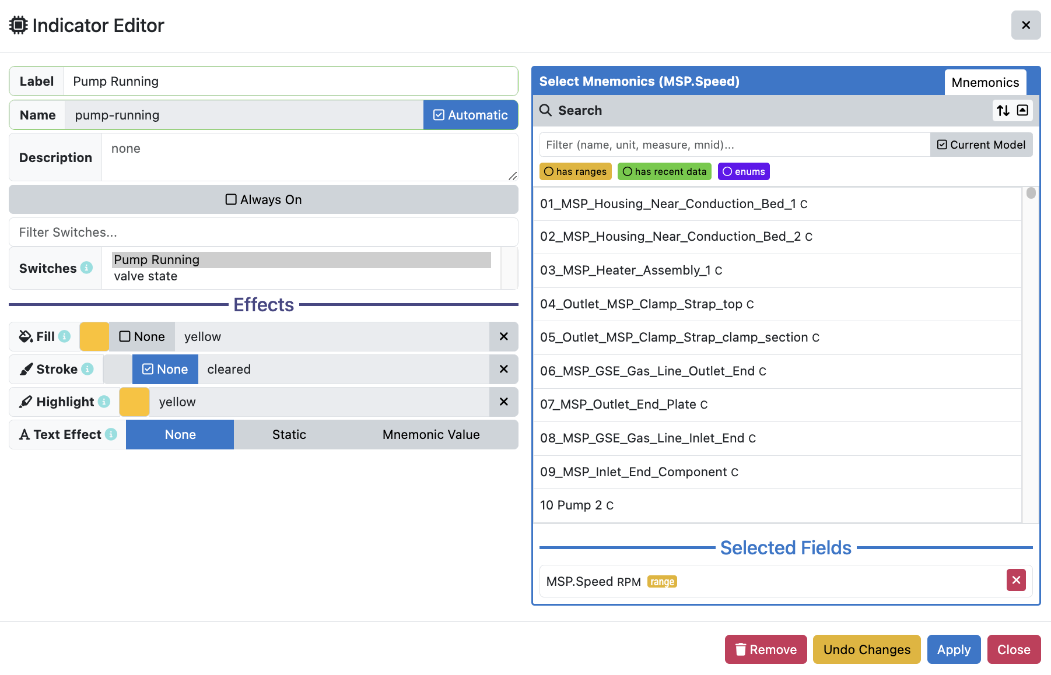
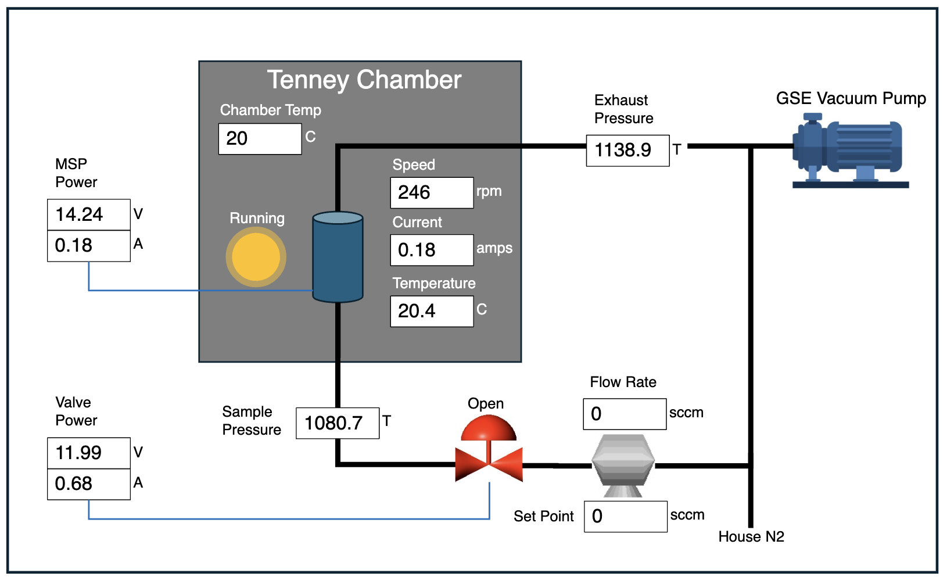
Indicator Configuration
When configuring an indicator, select a switch/mnemonic, then configure an effect when the switch is True. Different indicators have different effects.
For the “Pump Running” indicator, if the “Pump Running” switch is True, the circle under the “Running” label on the diagram fills in yellow.

Slide 17
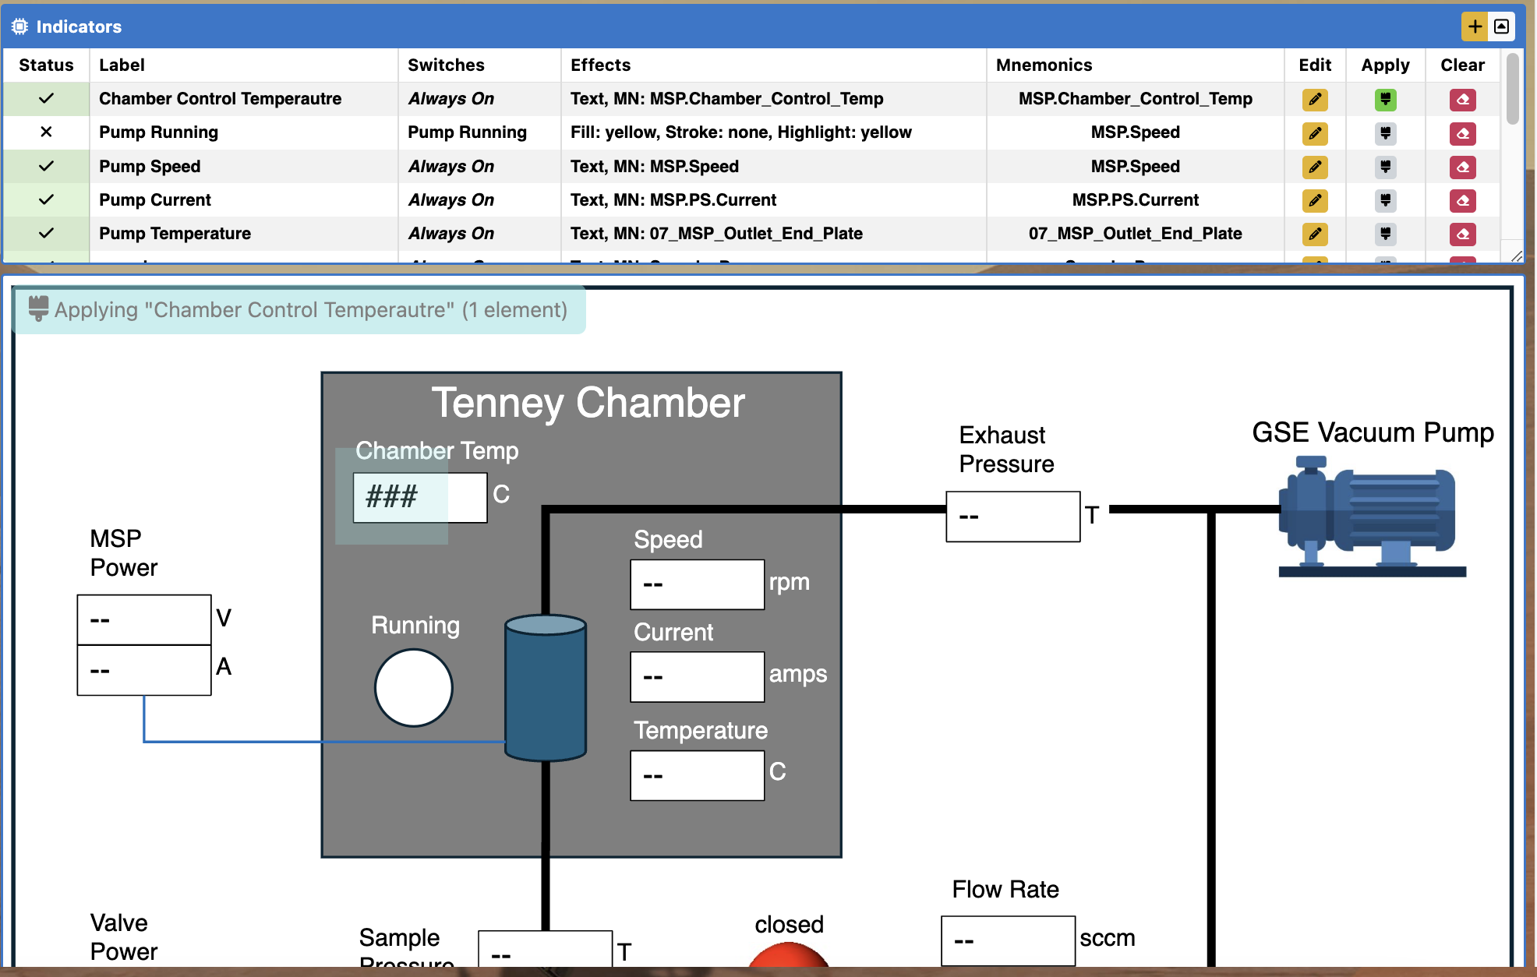
Applying Indicators
Clicking this icon allows you to apply the selected indicator to the diagram.

Slide 18
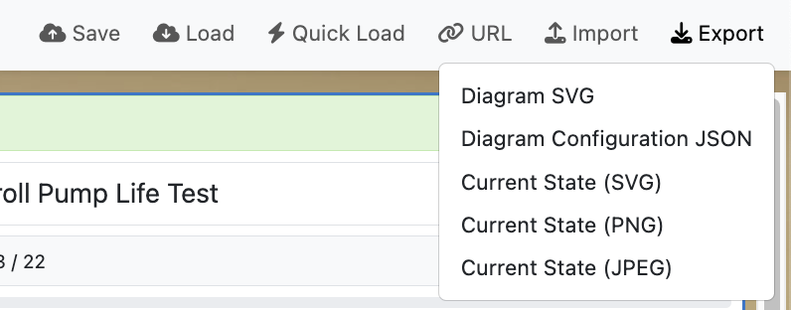
Exporting Files
To export any of the files from XINA, click the “export” button in the top-right and select the file that you wish to download.

Slide 19
Sharing, Saving, and Loading Configurations
It is possible to share and save the current state of the tool, as well as load a previously saved configuration. Please click here to view the sharing, saving, and loading tutorial.

