Slide 1
SAM SAGE v1.2 new features
09/20/12
Anna Brunner (anna.e.brunner@nasa.gov)
Micah Johnson (micah.s.johnson@nasa.gov)

Slide 2
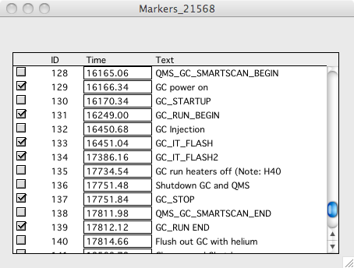
TM Markers

Slide 3
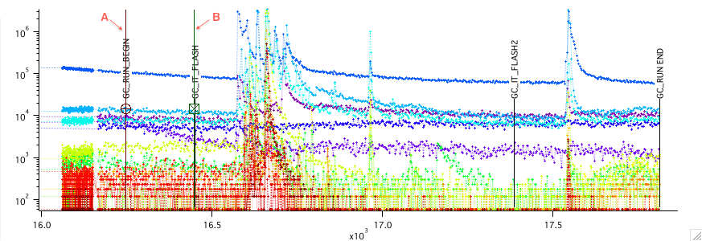
TM Markers
Background cursors and export time cursors will be able to “snap” to any displayed TM markers

Slide 4
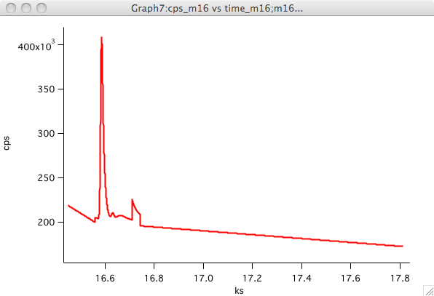
Export Fill-In Options – Line Fit
Smooth lines
Does not accurately model nonlinear backgrounds (sometimes there is runaway behavior)

Slide 5
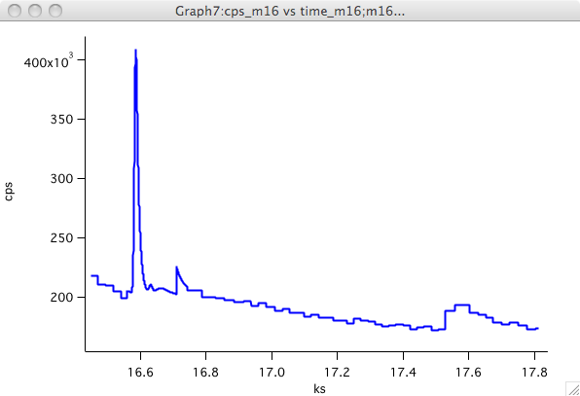
Export Fill-In Options - Average
Five point bins (based on number of points in raw data, not time)
Can more accurately model nonlinear backgrounds
Easier to see whether you missed a peak, or fitted a peak that wasn’t real

Slide 6
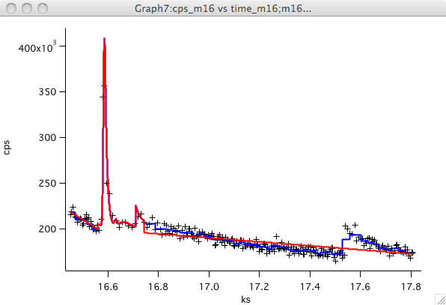
Export Fill-In Options - Comparison
Black points are raw data

Slide 7
Export Fill-In Options – Other Ideas?
“connect-the-dots” – constrained by start and end points (no runaways caused by nonlinear backgrounds)
Polynomial fit – runaways occur very easily, ways to constrain the endpoints need to be investigated

Slide 8
Deconvolution of Peaks and Mass Spectra

Slide 9
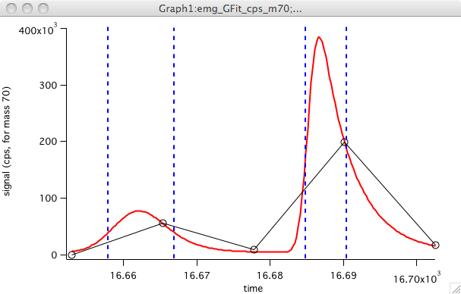
Deconvolution of Peaks and Mass Spectra
For each subpeak: generate a mass spec by plotting mass vs average height within FWHM bounds of deconvolved peak

Slide 10
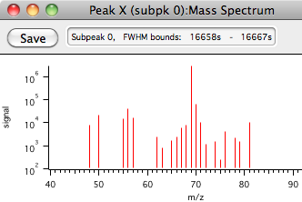
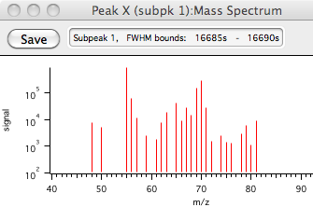
Deconvolution of Peaks and Mass Spectra
Save button creates NIST 11 compatible text file

