Slide 1
SAGE 1.7 updates
Anna Brunner
(anna.brunner@asu.edu)
7/18/14

Slide 2
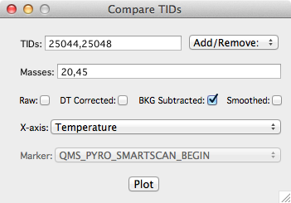
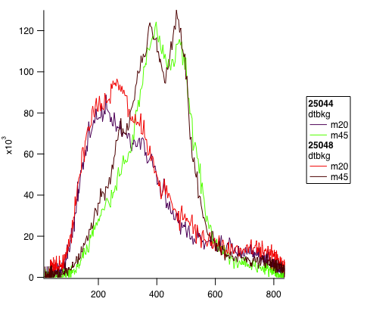
TID Comparison Plots
Macros > Compare TIDs…
This is a tool for quickly making plots to compare between TIDs, masses, and/or data corrections
Note: if temperature is selected as the x-axis, the temp profile used will be whatever temp waves were most recently generated by clicking the Plot button in the Pyro tab of the Overlays window (which may be different for each TID if you’re not careful)

Slide 3
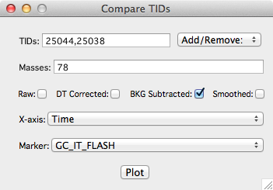
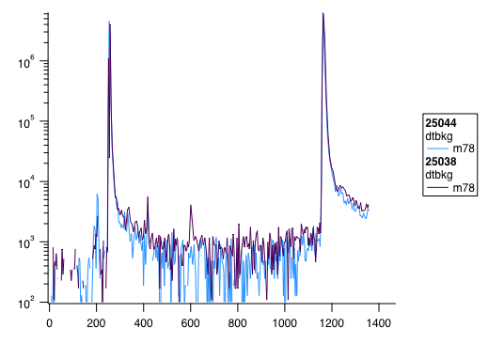
TID Comparison Plots
You can also plot the QMS signal against time, and align different TIDs by zeroing their x-axes to TM markers (such as GC IT FLASH, to compare chromatograms).

Slide 4
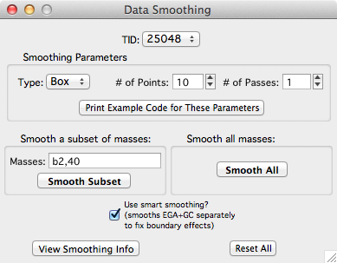
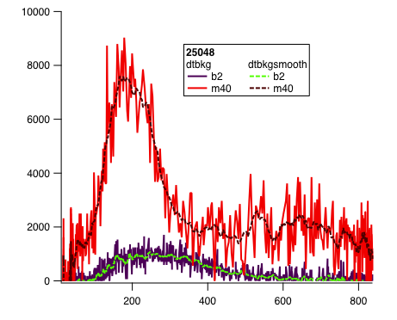
Smoothing
Macros > Smooth Data…
Smooth SAM data using boxcar, median, or binomial smoothing (see IGOR help files for details on each method)
Apply the smoothing just to a subset of masses (or bands), or to everything at once
“Smart smoothing” will split the data between EGA and GC (or EGA and noble gas enrichment) modes so that the endpoints of the sections don’t interfere with each other

Slide 5
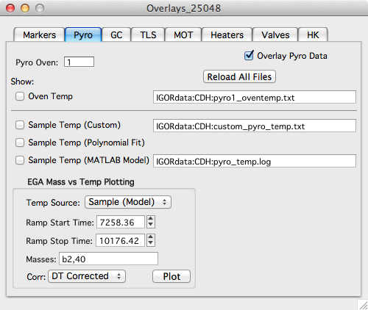
Custom sample temperature option
Because we are still figuring out how to estimate the oven 2 sample temperature, I wanted to add an option for loading a custom sample temp file. This adds flexibility, in case a new model or equation is developed, but can be ignored otherwise.
NOTE: custom_pyro_temp.txt must be user-generated and added to the TID folder. The format of custom_pyro_temp.txt is any number of comment lines preceded by “#” and then a time column and a temperature column (in that order).
Example custom_pyro_temp.txt contents:
# This is an example of a custom sample temp file.
# time (s) temp (degrees C)
1000.00 100.0
2000.00 200.0
3000.00 300.0

